Slide 1


SRO/SSO Incentive Grant Program - Continuations FY27 SRO and SSO Guidelines and Application Procedures
Jordy Nolan and Beth Polak
Grant Program Specialists
Virginia Center for School and Campus Safety

Slide 2
What to expect?
Reminders for FY27
Application Requirements
Priorities for New Applications
Application Restrictions
Completing an Application in On-line Grants Management System (OGMS)
Application Instructions
Technical Assistance
Application Review

Slide 3
FY27 Reminders
Applications are for continuation grants only, for up to four years.
Applications must be submitted under the locality’s registration in OGMS, not the school division’s.
SSOs and SROs must comply with training requirements within 60 days of serving in a school building.
SRO: TRACER Complete Historical Record (CHR) is required.
SRO: Process for certification and recertification of school resource officers (effective January 1, 2024).
SRO: applicants do not need to provide General Orders.

Slide 4
FY27 REMINDERS
Match is required.
Maximum amount per position is for state special funds and does not include match: $100,000 per SRO position $50,000 per SSO position
Equipment, training, and programming expenses are allowable under state special funds for grant-funded staff only (Low priority).

Slide 5

Application Guidelines

Slide 6
Application Requirements
Due March 10, 2026, by 5:00 p.m.
Must be completed and submitted through DCJS On-line Grants Management System (OGMS).
Application is for a position, not a specific school.
May not exceed $100,000 per SRO and $50,000 per SSO.
Local Match can include existing local costs for personnel, equipment, training, or other local costs.
Grants may not exceed a total of 48 months/four years.

Slide 7
Match Requirement
Use the Composite Index of Local Ability-to-Pay to determine the amount of your required match.
May use in-kind contributions or cash to meet the requirement.
In-kind = the value of an item or service received or provided that pertains to or directly supports the specific project activities funded by the grant.
Cash = the locality’s own funds allocated for the project.
Non-federal sources.
Must be reported on quarterly claims and be fully met by the end of the grant year.
Match is included in the total budget (state funds + match = total budget).

Slide 8
Match Requirement Example 1
Calculate the amount of required local match by multiplying the total project costs by the locality’s composite index (.3032)
Total Project Costs x Composite Index = Total Local Match
$100,000 x .3032 = $30,320
Calculate the amount the locality can request under Special Funds by subtracting the local match from the total project costs.
Total Project Costs - Total Local Match = Total Special Funds
$100,000 - $30,320 = $69,680
Therefore, ABC City can request $69,680 in Special Funds and must provide a local match of $30,320 for a total project cost of $100,000.
The total cost to implement the project is $100,000 including salary, fringe benefits, supplies, and training. ABC City’s Composite Index of Local Ability-to-Pay is .3032.

Slide 9
Match Requirement Example 2
To implement the project, ABC City must receive $50,000 for salary and fringe benefits and $3,000 for supplies for a total request of $53,000 in Special funds from DCJS. ABC City’s Composite Index of Local Ability-to-Pay is .3032.
Calculate the special funds portion by subtracting the composite index from 1.00.
1.00 - Composite Index = Special Funds portion
1.00 - .3032 = .6968
Calculate the total project costs by dividing the special funds needed by the special funds portion.
Special Funds/Special Funds portion = Total Project Costs
$53,000/.6968 = $76,062
Calculate the local match by multiplying the total project costs by the locality’s composite index.
Total Project Costs x Composite Index = Total Local Match
$76,062 x .3032 = $23,062
Therefore, ABC City must provide a local match of $23,062 to request $53,000 from Special funds for a total project cost of $76,062.

Slide 10
Application Requirements: SRO
Must be certified law enforcement officers as defined in the Code of Virginia § 9.01-101 and employed by a lawfully established public police department or sheriff’s office.
Must comply with the minimum training standards established by the Board as required under the Code of Virginia § 9.1 - 114.1 within 60 days of first date serving in a school building.
Must serve one designated school.
Must have an MOU, pursuant to Code of Virginia § 22.1 - 280.2.3, between the School Division and Law Enforcement agency that is reviewed at least once every two years.

Slide 11
Application Requirements: SRO
Certified law enforcement are expected to perform their duty as law enforcement officers and follow their agency’s general orders or standard operating procedures.
An SRO is full-time if employed as a certified law enforcement officer year-round and is dedicated to the school during school hours.
For scheduled school breaks the agency has flexibility to assign the SRO as needed in other areas of the agency.

Slide 12

Application Requirements: SSO
An SSO is an individual who is responsible for ensuring the safety, security, and welfare of all students, faculty, staff, and visitors in the assigned school and is employed by the local school board to:
Maintain order and discipline
Prevent crime
Investigate violations of school board policies
Detain students violating the law or school board policies on school property or at school-sponsored events

Slide 13
Application Requirements: SSO
Must comply with requirements set out in the Virginia Administrative Code, Title 6, Agency 20, Chapter 240: Regulations for School Security Officers.
The SSO must complete first aid training, compulsory minimum entry-level training, and pass all portions with 80% or higher within 60 days of hiring date.
Not exempt from holiday or break from the academic year.
Must request an extension if training is not available within initial 60 days.
Once certified, the SSO is required to complete 16 hours of DCJS-approved school security-related training (including a legal portion,) over a two-year period to maintain certification.

Slide 14
Application Restrictions
Continuation applications are being accepted for: Grantees whose four-year cycle has not ended Grantees whose FY26 grants are in the 4th year and end in the letter "D." These will be considered based on availability of funding. Grant is for the position and not a specific school Changes to the assigned school must be reported.
Grant funds cannot be used for staff that aren’t performing the activities of the project.
SRO grant funds cannot be used for general security or extracurricular/coaching activities.
Grant funds cannot be used to fund positions at private schools or contracted schools.

Slide 15
Allowable: Equipment and Supplies
Equipment: tangible personal property having a useful life of more than one year and a per-unit costs which equals or exceeds $10,000. All other expenses should be itemized as supplies.
Pro-rate: grant funds cannot support the entire cost of an item that is not used exclusively for grant project-related activities; however, grant funds can support a pro-rated share of such an item.
Equipment and supply expenses can include, but are not limited to: Computers/laptops Locked filing cabinets Safes/locked cases Office supplies Cellphones Two-way radios Uniforms DUI goggles

Slide 16
Allowable: Programming
State special funds can be used for education-based programming expenses that enhance the school-law enforcement partnership.
Expenses can include, but are not limited to:
Training or awareness materials
Educating students on public safety topics
Virginia Rules
Suicide prevention
Bullying prevention
Trauma-sensitive care of students

Slide 17
Allowable: Training
State special funds can be used for expenses related to attending DCJS-sponsored or facilitated trainings and professional development events relevant to school safety.
Conferences must be in-state, DCJS-sponsored conferences, including, but not limited to:
School Safety Training Forum
First Responder Wellness Conference
Regional Threat Assessment Forums
Conference on Violent Crime

Slide 18
Unallowable Expenses
The following activities and/or expenses cannot be supported with these funds or used as local match*:
Expenses related to the purchase of firearms, handcuffs or other wrist restraints, or any stun weapon as defined in Code of Virginia § 18.2 - 308.1
Consultants
Private security
Food or beverage for any meeting, training, or event
Vehicles or vehicle maintenance (*These expenses may be used as local match only)
Capital expenses
Hosting, coordinating, or organizing local or regional conferences and trainings

Slide 19

On-Line Grants Management System (OGMS)

Slide 20
Register in OGMS
Every user who manages a DCJS grant will need to register for an account.
Includes individuals responsible for submitting a grant application, completing status reports, entering claims, and requesting funds.
Project directors, project administrators, and finance officers are encouraged to register.
Individuals must be added as an additional contact on the application to have access.

Slide 21
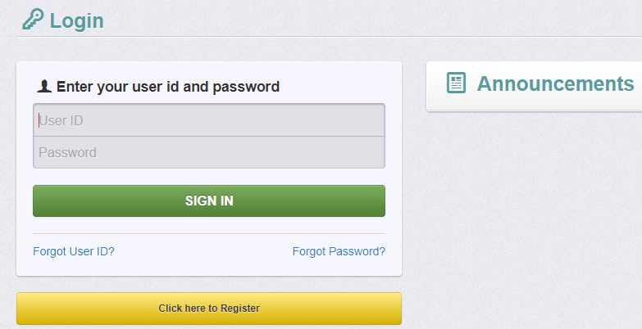
Register as a New User
URL: www.ogms.dcjs.virginia.gov
Click on, “Click here to Register”

Slide 22
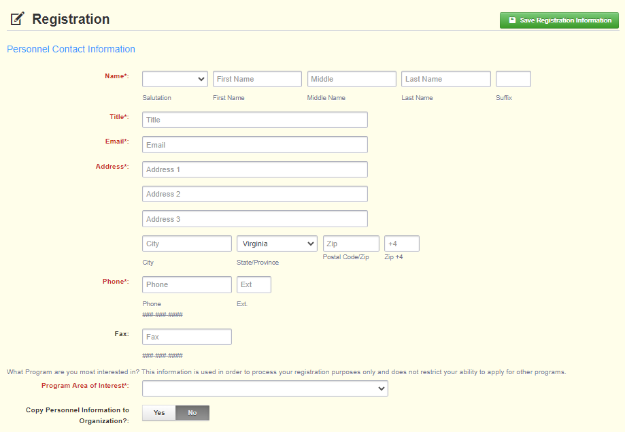
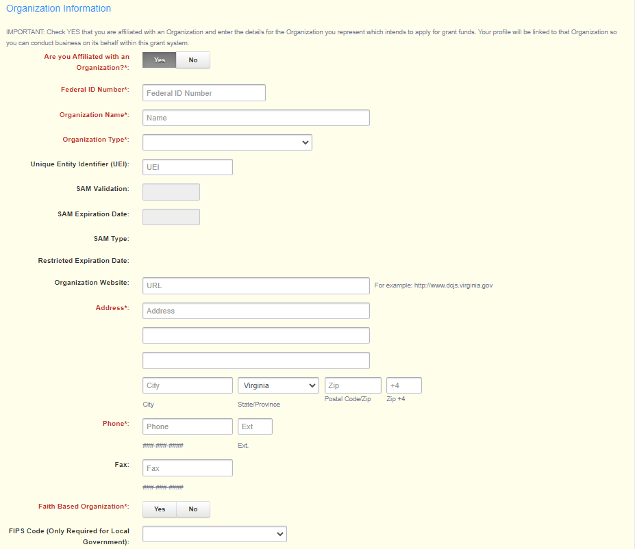
Register as a New User
All required fields are shown with a red asterisk *
Program Area of Interest is “FREE”

Slide 23
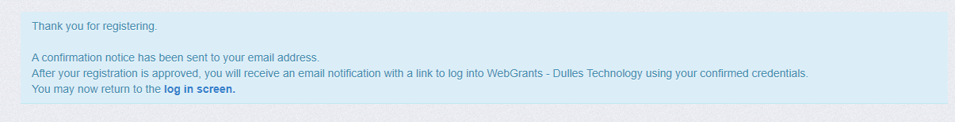
Register as a New User
You will receive a confirmation of your registration stating an alert notification has been sent to your email address.

Slide 24
Register as a New User
Email #1: Your registration is under review.
Email #2: Provides your user ID and temporary password.
Each email provides the URL for logging into OGMS.
Log in.
Alerts/notifications come from VAgrantsDCJS@webgrantsmail.com

Slide 25

Application Instructions

Slide 26
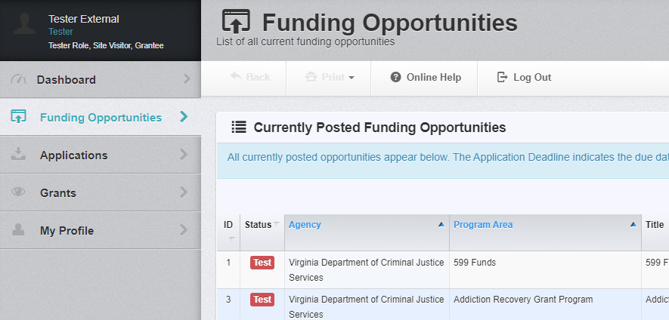
Find a Funding Opportunity
After logging in, select “Funding Opportunities” and then click on the opportunity for which you want to apply.
#567166 - FY27 School Resource Officer Continuation Grants – SRO
#567211 FY27 School Security Officer Continuation Grants - SSO

Slide 27
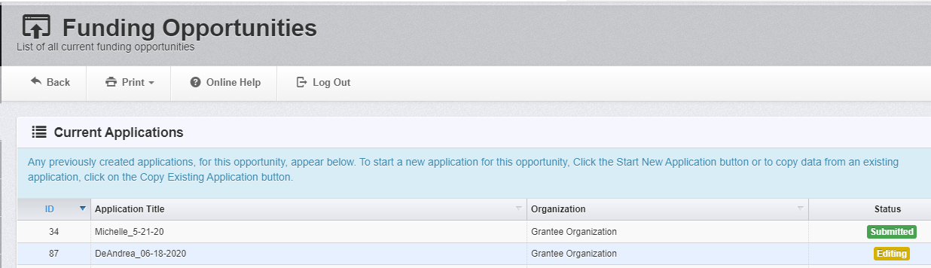
Funding Opportunity
In the Funding Opportunity, “Current Applications” shows any previously created applications for this opportunity.
The Status column shows if an application has been submitted or is still in the editing phase.

Slide 28
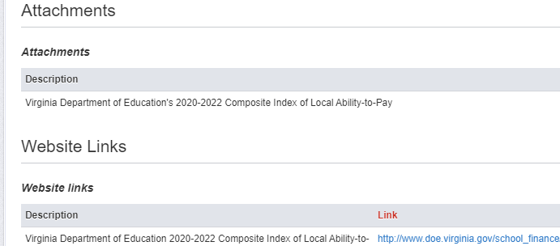
Funding Opportunity
After clicking on the funding opportunity, the grant Description includes:
Introduction
Eligibility
Grant Application Deadline
Amount Available
Priorities for New Applications
Grant Period
Match Requirements
At the bottom of the page, Attachments and Website
Links shows documents or website addresses that will assist you with completing the application.

Slide 29
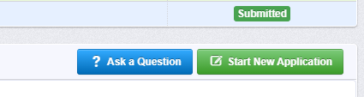
Start an Application
Ask a Question: If this appears at the top right of the Funding Opportunity Details, you can ask questions that will appear at the bottom of the funding opportunity (FO) for other applicants.
Start New Application: Click to create a new application. You must go through the Wizard before the application can be saved. Once saved, you can go back anytime to edit.

Slide 30
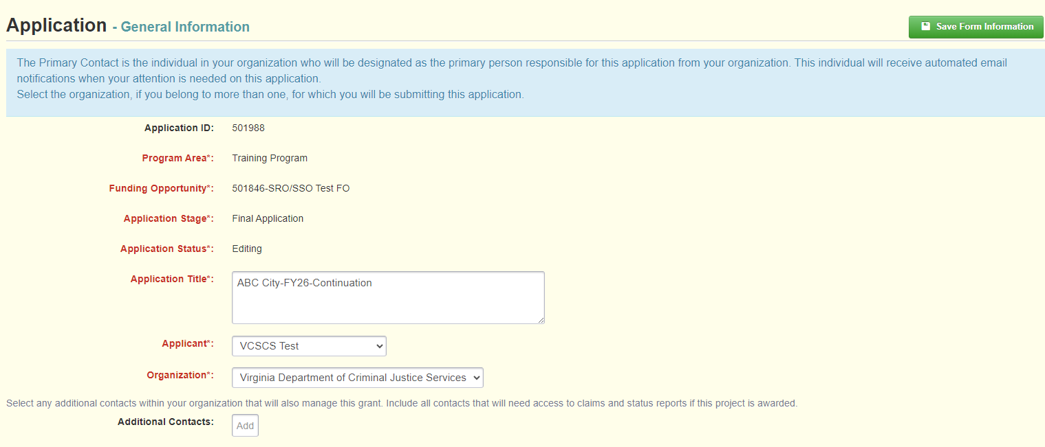
Application Creation Wizard
Application Title: Name your application with your locality’s name
ex: ABC City-FY27-New
Primary Contact: your Project Director
Organization: Select your organization

Slide 31
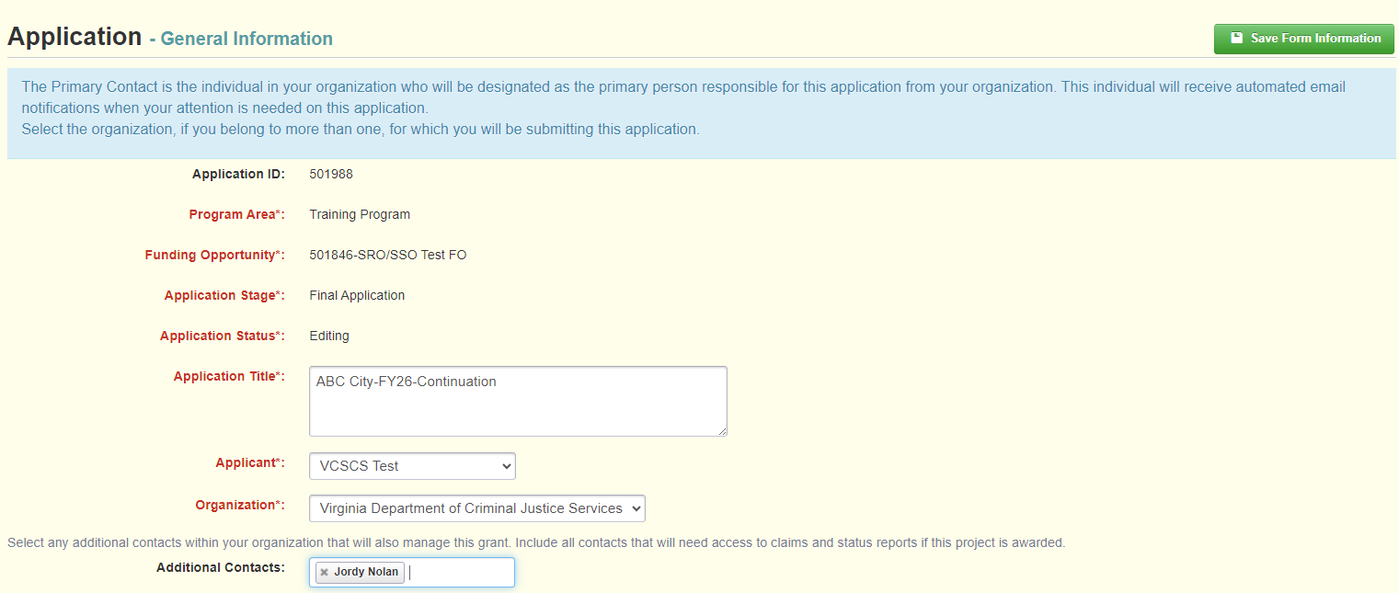
Application Creation Wizard
Additional Contacts: Add people in your organization who need access to the grant. If someone is not listed as an additional contact, they will not be able to see the application or the grant in OGMS.

Slide 32
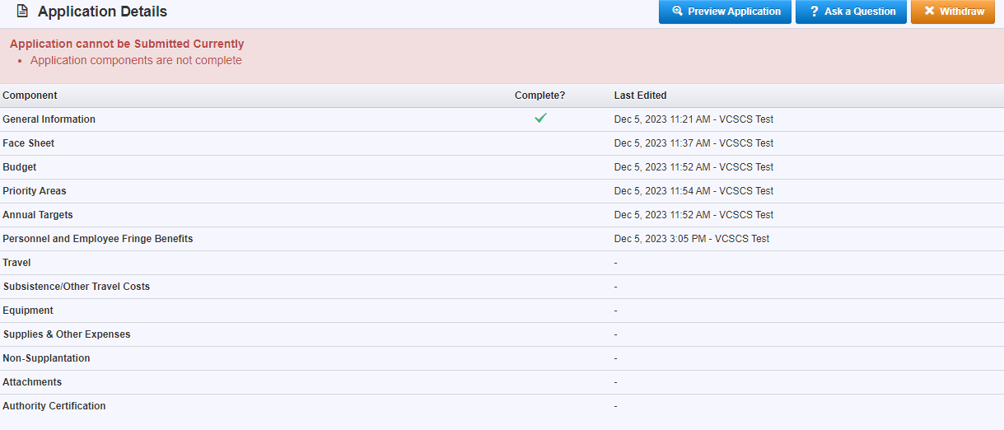
Application Details
A green checkmark in the Complete column means that section is completed. If there is not a green check mark, you still have required info to enter. Your application cannot be submitted until all sections are complete.

Slide 33
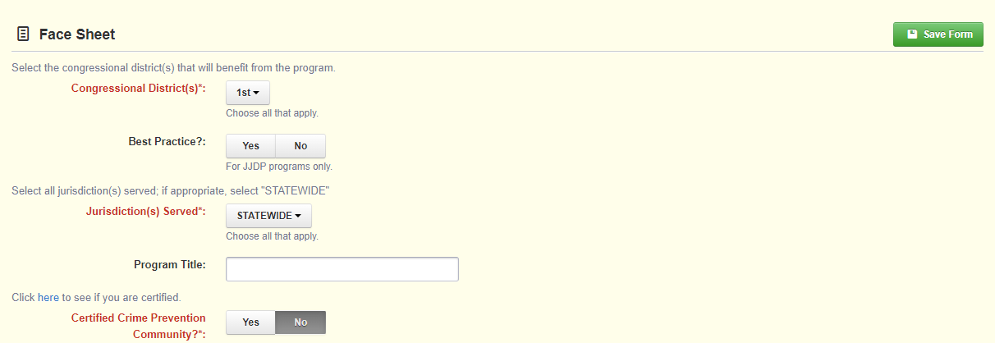
Face Sheet Example

Slide 34
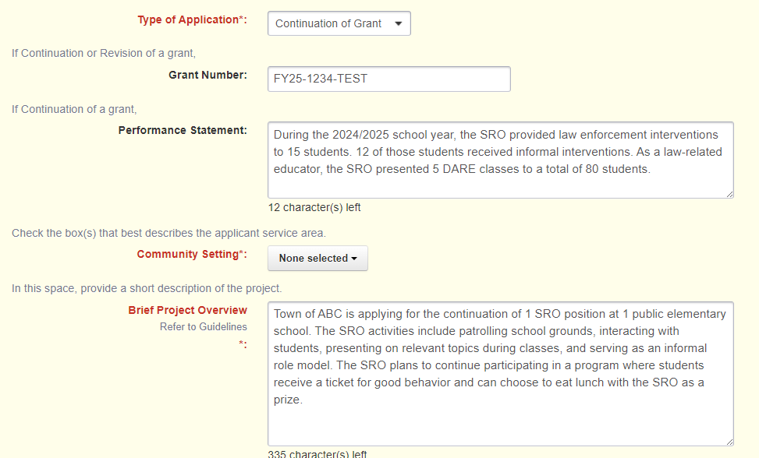
Face Sheet example

Slide 35
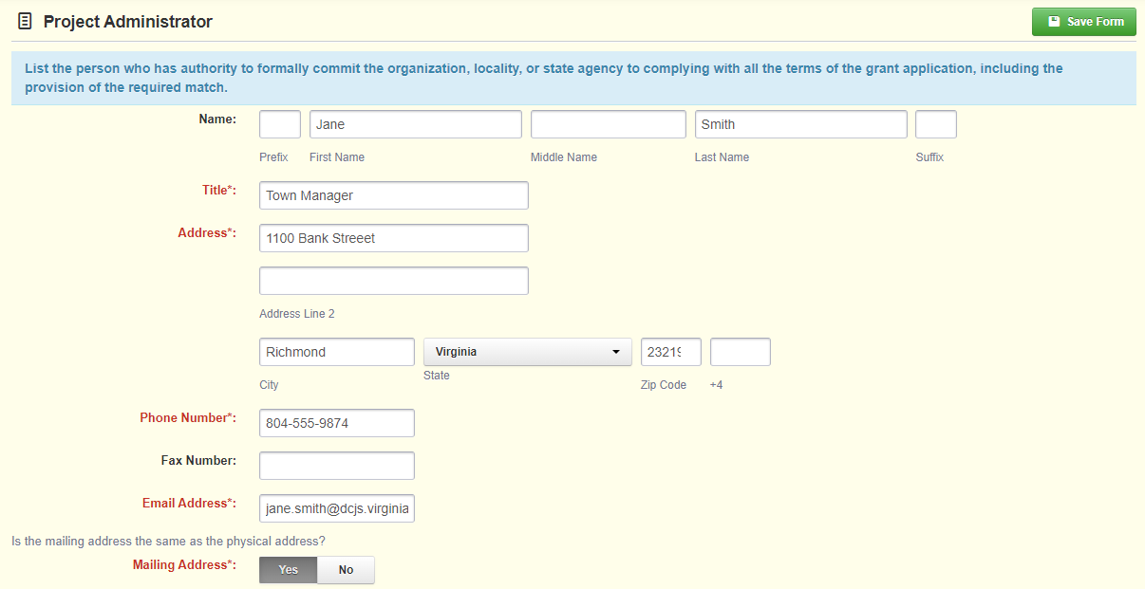
Face Sheet example

Slide 36
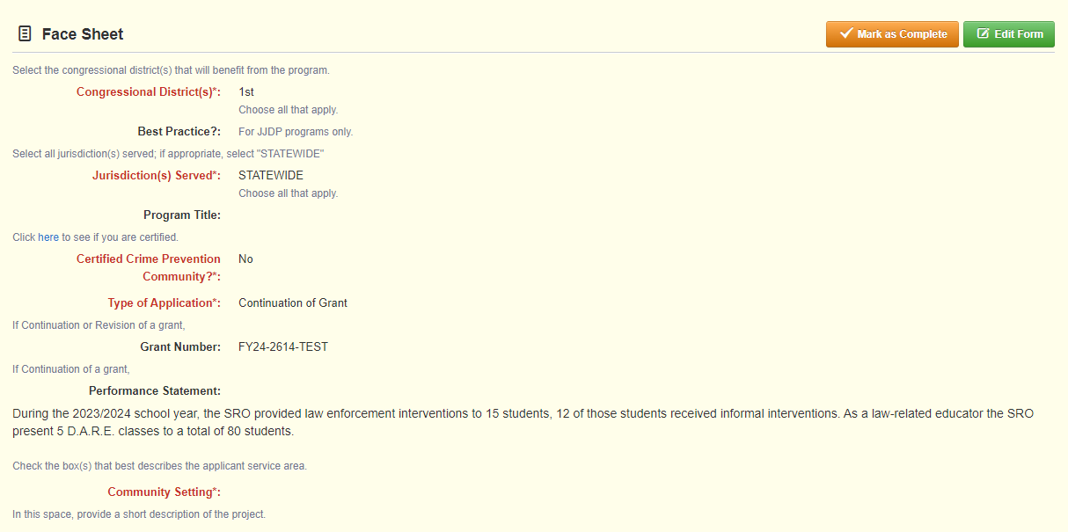
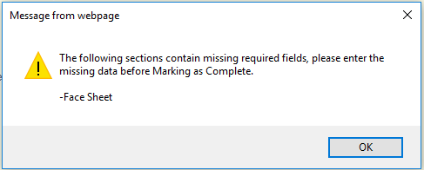
Face Sheet example
After completing all fields, click on the orange “Mark as Complete” button. If a field is not complete, you will receive an error message.

Slide 37
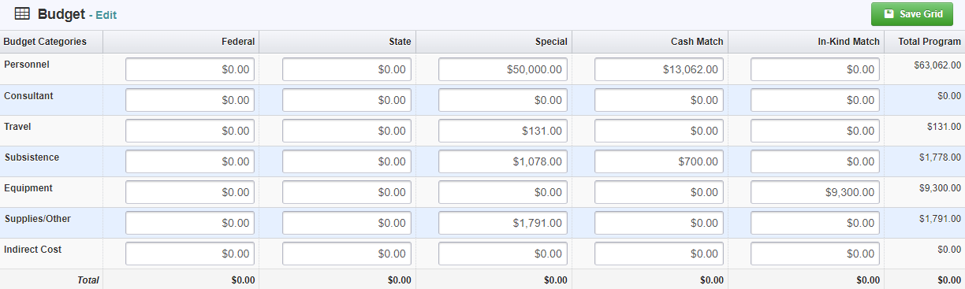
Budget
Enter the requested DCJS amount under the “Special” column.
Do not enter anything under the Federal or State columns.

Slide 38
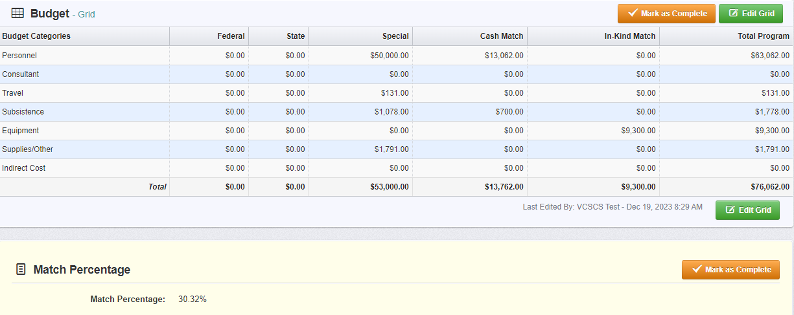
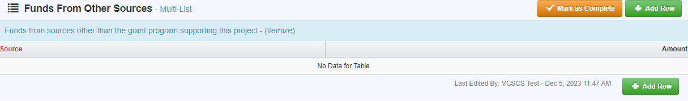
Budget
After entering Special and Cash Match Amount, click Mark as Complete. The page will refresh, and your match percentage will automatically calculate. You may also enter Funds From Other Sources.

Slide 39
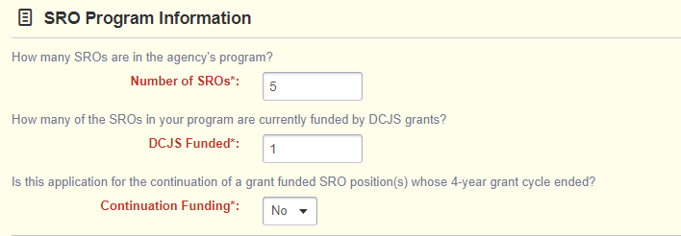
Priority Areas– Program Information
Enter the number of SROs or SSOs (both grant-funded and non-grant-funded staff) in the agency’s existing program.
Enter how many of the positions are currently funded by any DCJS grant.
Continuation
“Yes” if applying for the continuation of a grant funded SRO or SSO
Explain attempts to seek other funding for the position.

Slide 40
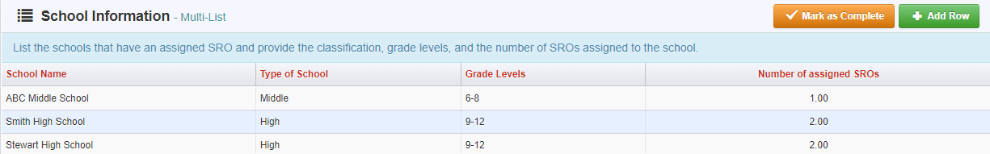
Priority Areas– School Information
SRO Applications: list the schools with an assigned SRO, both locally- and grant-funded.
SSO Applications: list the schools with an assigned SSO, both locally- and grant-funded.
Provide classification, grade levels, and the number of SROs/SSOs assigned to the school.

Slide 41
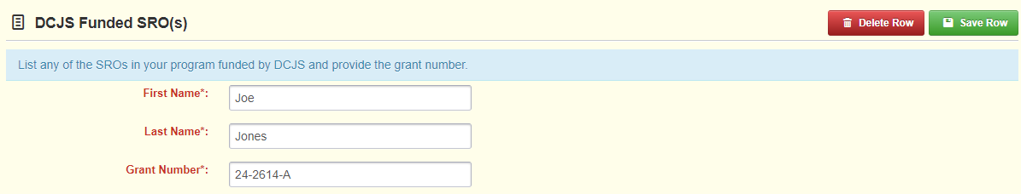
Priority Areas– DCJS Funded
SRO Applications: List SROs in your program funded by any DCJS grant.
SSO Applications: List SSOs in your program funded by any DCJS grant.

Slide 42
Project Targets: SRO
Law Enforcement Activities:
Enter the number of times, over the course of the grant year, the SRO(s) anticipates performing the activities in this section.
1
Law Related Educator:
Enter the number of presentations for the grant year that the SRO(s) plans to facilitate for each audience type.
2
Informal Mentor:
Enter the number of times, over the course of the grant year; the SRO(s) anticipates performing the activities in this section.
3

Slide 43
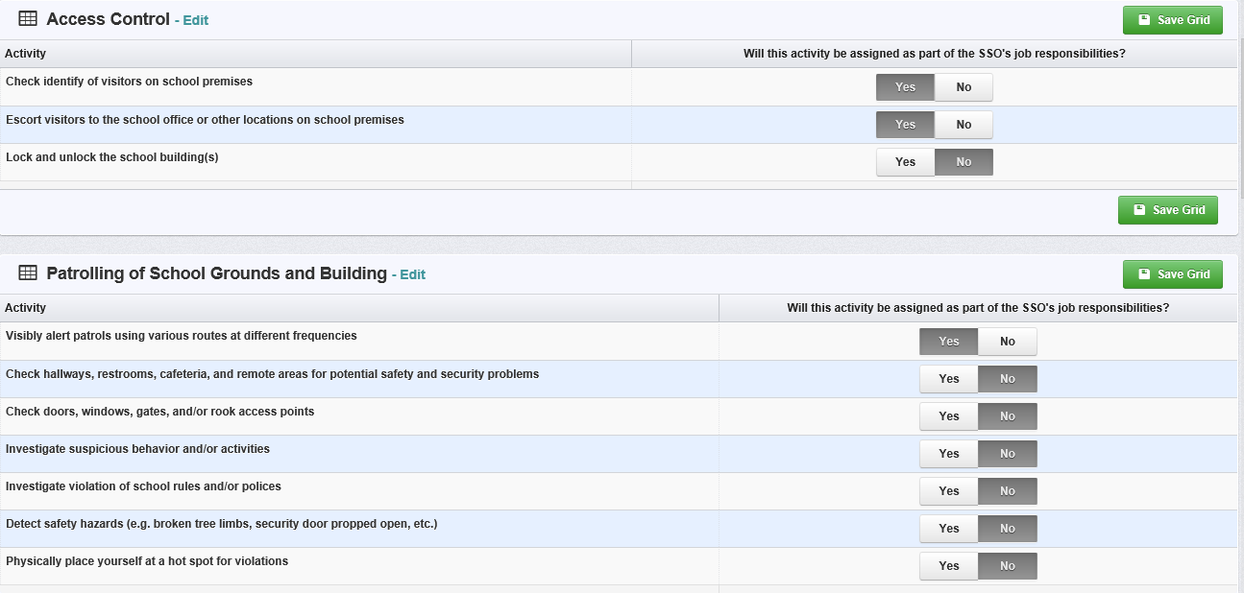
Project Targets: SSO

Slide 44
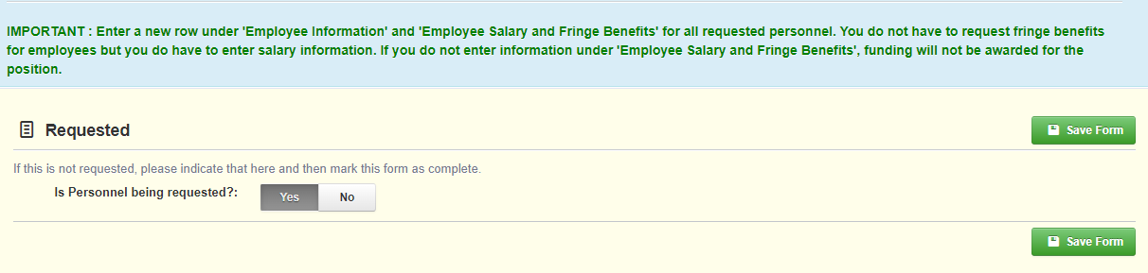
Personnel and Fringe Benefits

Slide 45
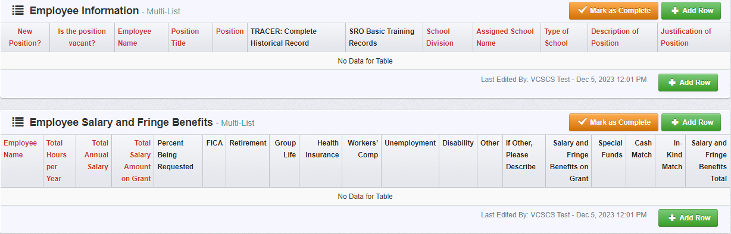
Personnel and Fringe Benefits
Employee Information
Employee Salary and Fringe Benefits

Slide 46
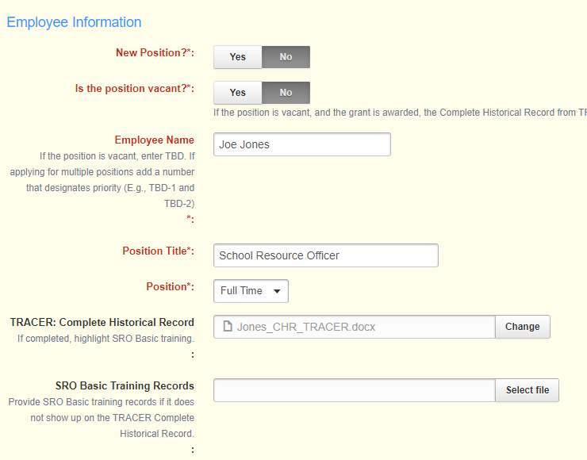
Employee Information: SRO
Enter the employee’s name/title
Enter TBD if the position is vacant.
Considered full-time if they are employed as a certified law enforcement officer year-round and are dedicated to the school during all school hours.
Any variations to this schedule would be considered part-time for grant purposes.
Required: TRACER: Complete Historical Record (CHR)
TBD: the CHR will be required when the position is filled.

Slide 47
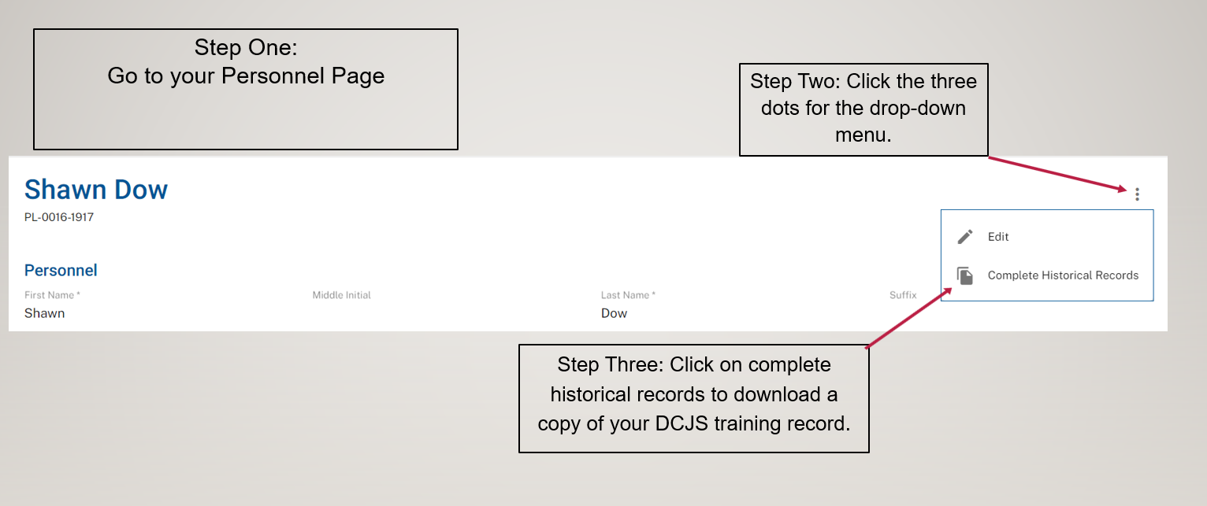
Employee Information: CHR
How to find the Complete Historical Record (CHR) in TRACER

Slide 48
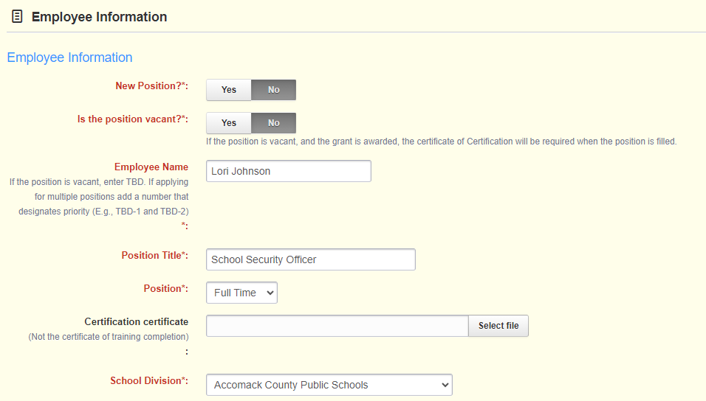
Employee information: SSO
Enter the employee’s name/title
Enter TBD if the position is vacant.
Indicate if the position is considered full-time or part-time according to the applicant's human resource status.
Required: certificate of Certification
TBD: the certificate will be required when the position is filled.
If not certified:
Provide proof of registration in an Initial Certification training.
Provide an approved extension request.

Slide 49
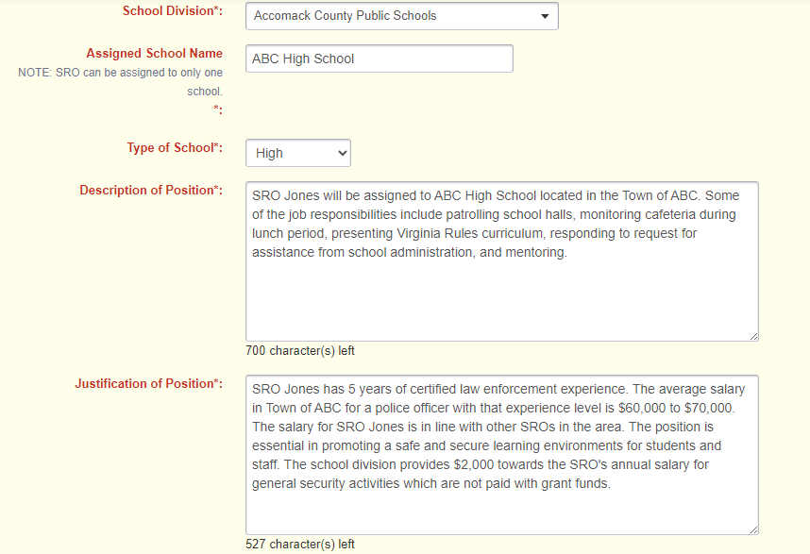
Employee Information: SRO and SSO
Select the School Division
Description of Position: explain grant-related duties
Justification of Position: explain how it is essential and how salary and fringe are consistent with locality policies

Slide 50
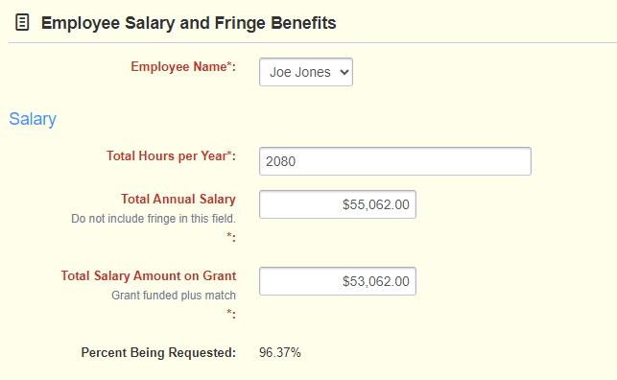
Employee Salary and Fringe Benefits
Total Annual Salary: total annual salary to include grant-funded, local match, and other funding sources, but don’t include fringe
Total Salary Amount on Grant: amount of salary you are requesting on the grant to include match

Slide 51
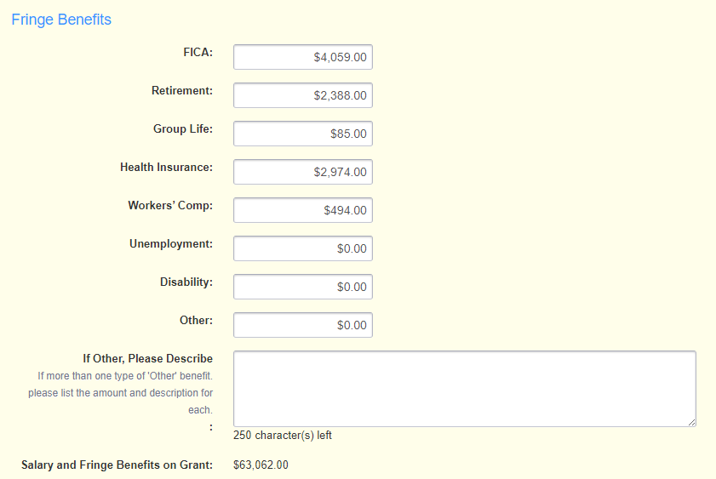
Employee Salary and Fringe Benefits
Enter the amount of each benefit requested
If “Other,” describe and break down the costs.
Salary and Fringe Benefits on Grant auto calculated

Slide 52
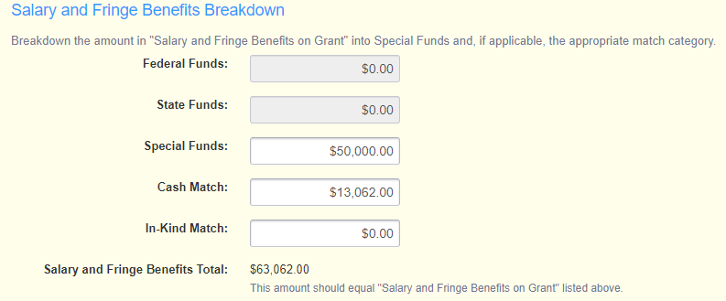
Employee Salary and Fringe Benefits
Break down “Salary and Fringe Benefits on Grant” into Special Funds and, if applicable, local match.

Slide 53
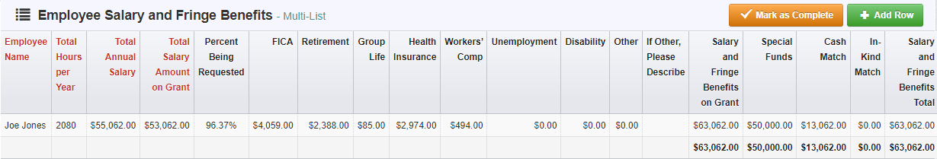
Employee Salary and Fringe Benefits
“Salary and Fringe Benefits on Grant” = “Salary and Fringe Benefits Total”

Slide 54
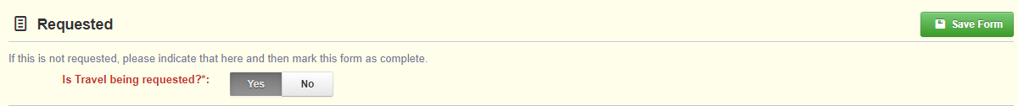
Budget Categories
Budget Categories:
Travel
Subsistence/Other Travel Costs
Equipment
Supplies and Other Expenses
If requesting funding or providing match in a category other than personnel, answer “Yes” at the top of the form
If not, answer “No”
Click “Save Form”

Slide 55
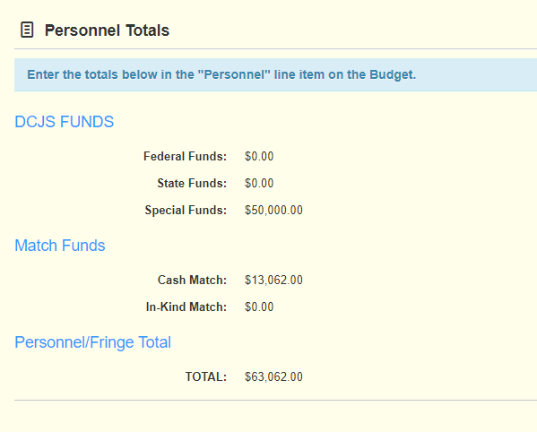
Budget Categories
Totals for all expenses entered in the form
Applicable line item on the Budget

Slide 56
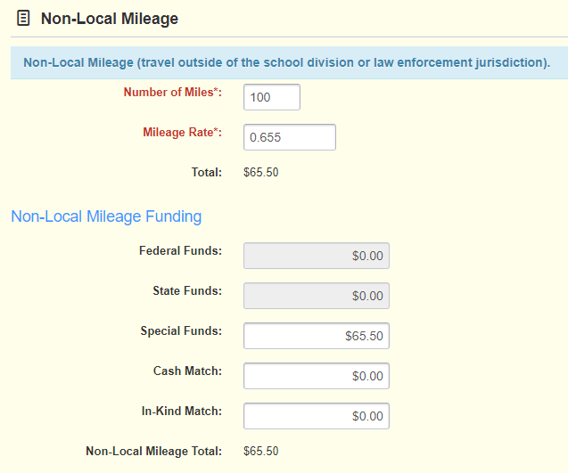
Travel
Follow local or state travel policy
Travel = Mileage expenses
Local = travel within the school division or law enforcement jurisdiction
Non-Local = travel outside of the school division or law enforcement jurisdiction
Break down “Total” under “Special” and/or the appropriate match field

Slide 57
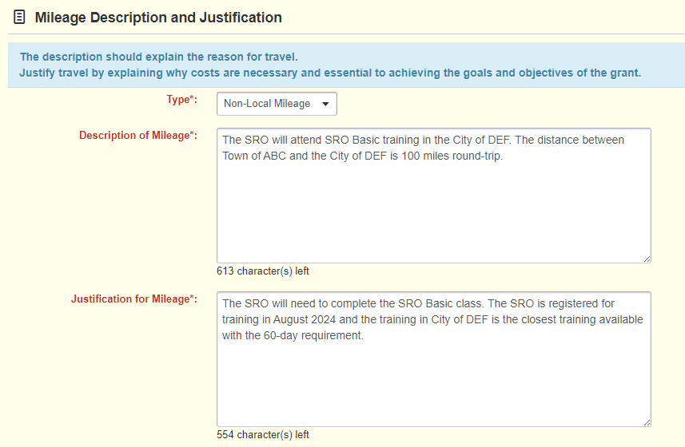
Travel
Description of Mileage
Reason for travel
Justification of Mileage
Why costs are necessary
Explain why local travel policy is different from the state policy

Slide 58
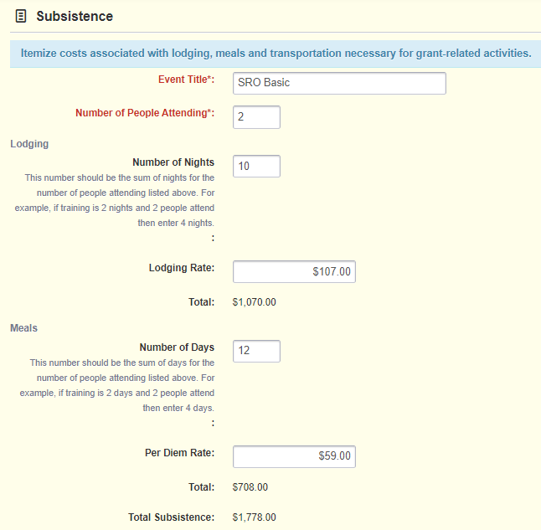
Subsistence/Other Travel Costs
Subsistence = lodging and per diem
Number of People Attending
Number of Nights (sum of all people attending)
Lodging Rate per night
Number of Days (sum of all people attending)
Per Diem Rate per day
Other Travel Costs = parking, tolls, etc.
Airfare is unallowable

Slide 59
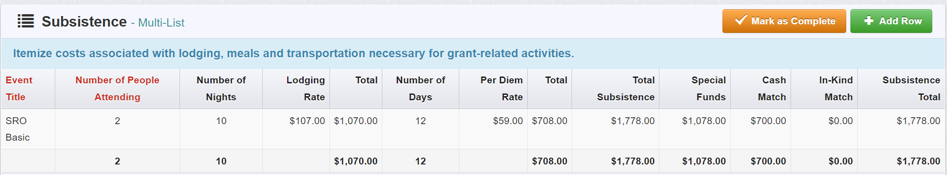
Subsistence/ Other Travel Costs
Break down “Total Subsistence” under “Special” or appropriate match field
“Total Subsistence” = “Subsistence Total”

Slide 60
Subsistence/ Other Travel Costs
Description of Costs
Describe the event for which travel is required. Provide location and dates if known.
Justification of Costs
Explain why the event and costs are necessary and essential. If location and dates are unknown, explain how costs were determined.

Slide 61
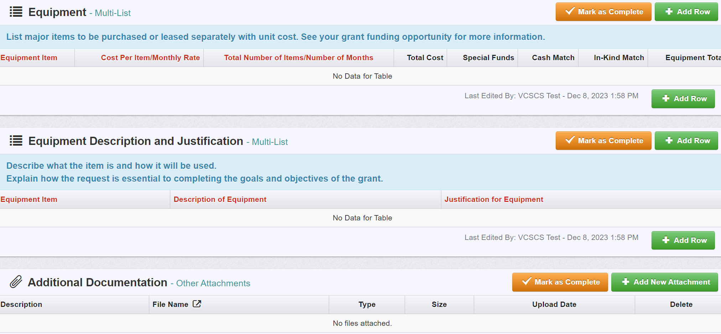
Equipment
Equipment = property with a useful life of more than one year and a per-unit cost of $10,000 or greater
Track, manage, and dispose of equipment consistent with locality policies
Pro-rate items not exclusively used for the project

Slide 62
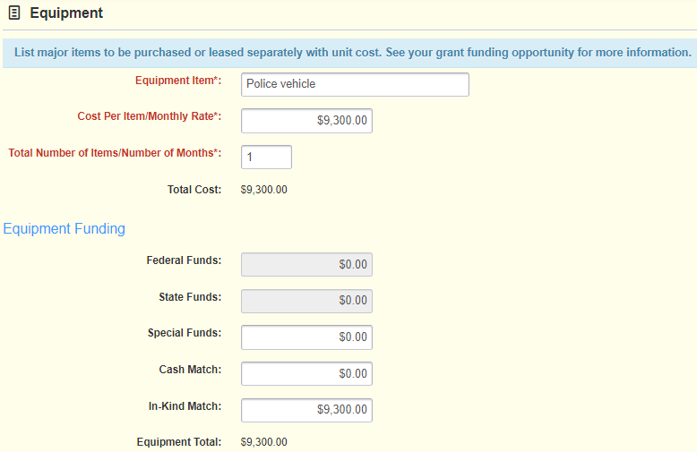
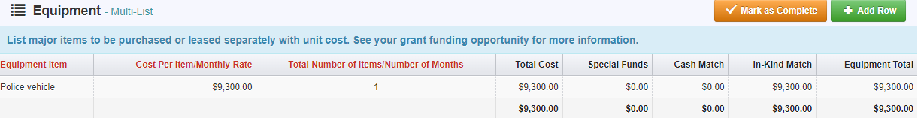
Equipment
Enter equipment item
Cost Per Item
Total Number of Items
The total cost will auto-calculate.
“Total Cost” = “Equipment Total”

Slide 63
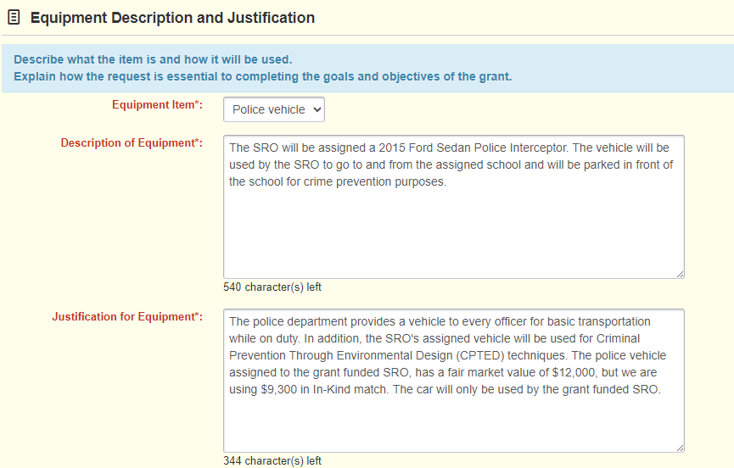
Equipment
REQUIRED:
Description: Describe the item and how it will be used.
Justification: Explain why necessary and how costs were determined.

Slide 64
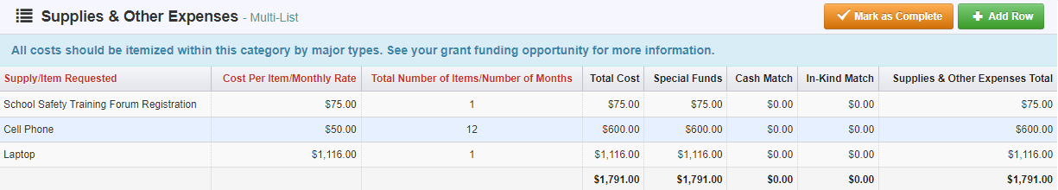
Supplies and Other Expenses
Supplies can include:
Registration fees
Office supplies
Cellphones
Uniforms
Items that don’t meet the definition of equipment
Pro-rate items not exclusively used for the project

Slide 65
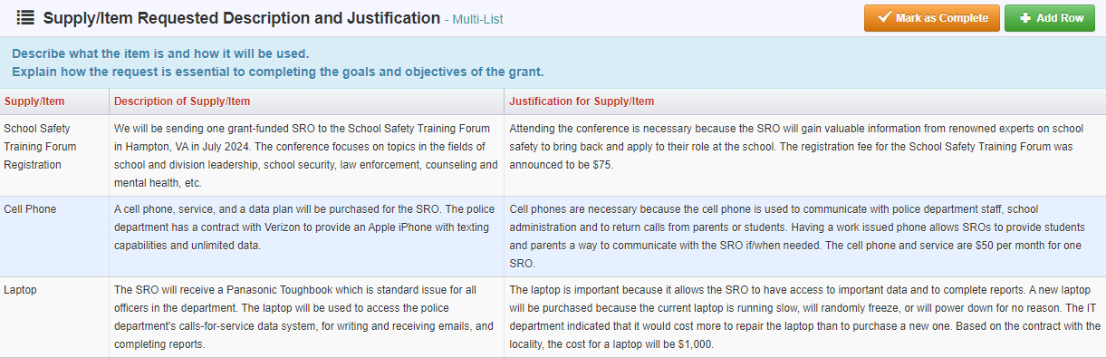
Supplies and Other Expenses
Description of Supply/Item
Describe the item and how it will be used
Justification of Supply/Item
Explain why the item is essential and how the amount was determined

Slide 66
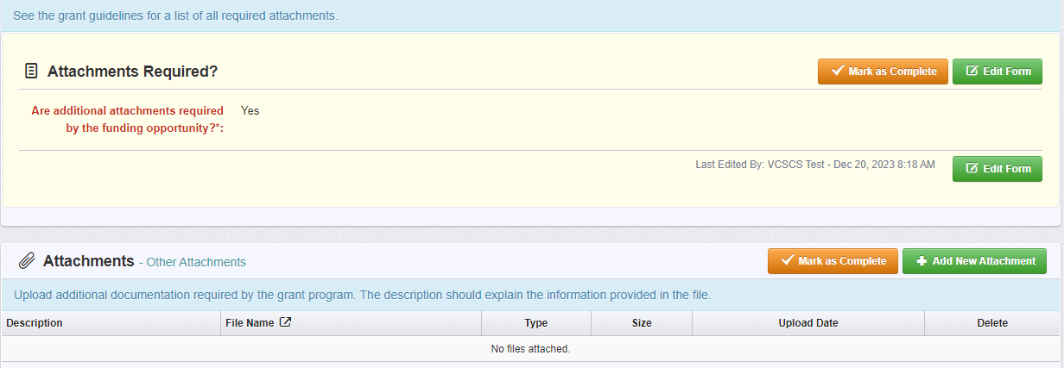
Attachments
Required: SRO MOU
Only if applicable: Signing authority letter

Slide 67
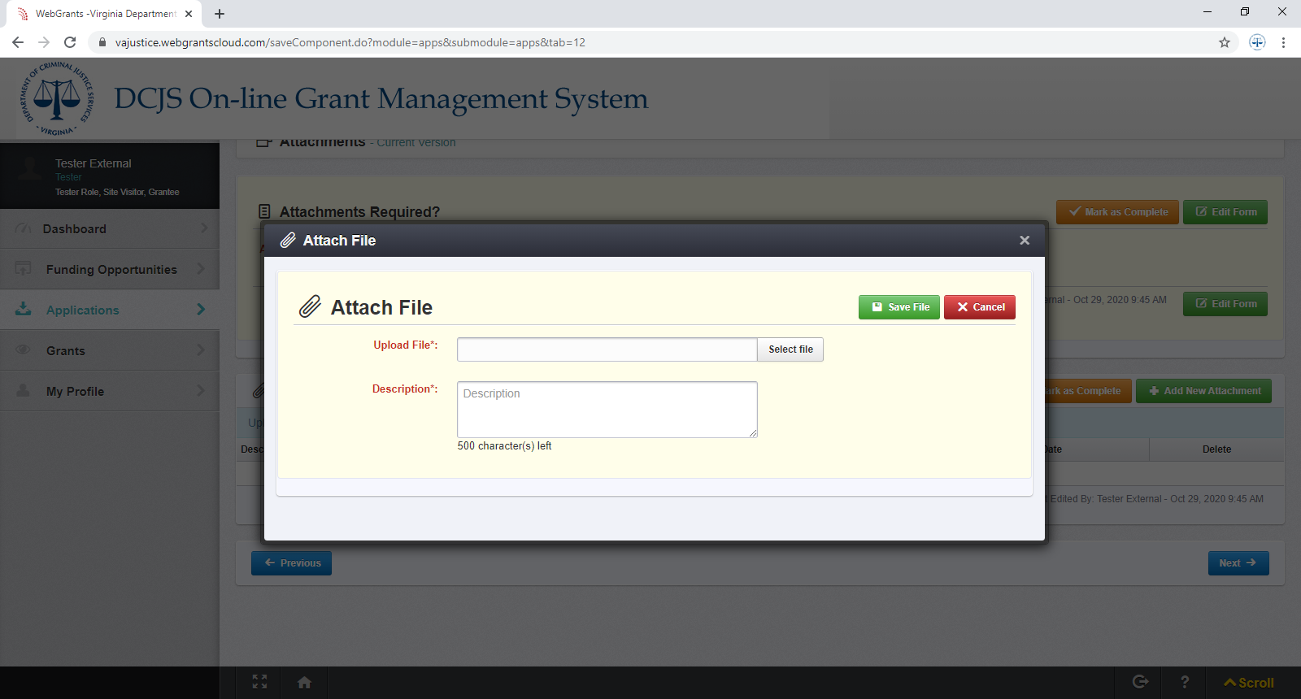
Attachments

Slide 68
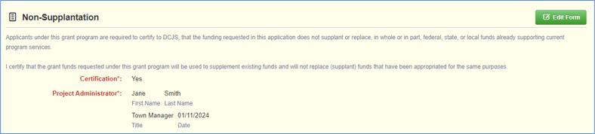
NON-SUPPLANTATION
Certification that grant funds will be used to supplement existing funds and will not replace (supplant) funds appropriated for the same purpose.​
Grant assurances are the sole responsibility of the locality accepting the grant.

Slide 69
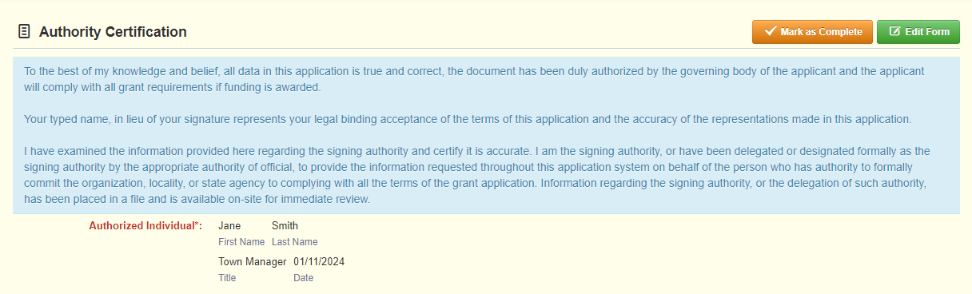
Authority Certification
Signing authority documentation should be uploaded under Attachments.

Slide 70
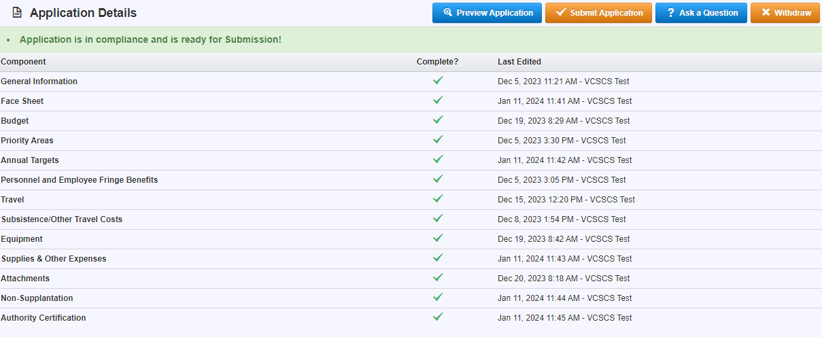
Submitting the Application

Slide 71

Submitting the Application
Review the entire application!
Make sure budgets match, information is correct, and all required items are provided.

Slide 72
Submitting the Application
Current Applications listing:

Slide 73

What’s Next?

Slide 74

Application Review
Grant awards are contingent on the availability of funding within the SRO Fund as appropriated by the state budget bill.
Grants may be funded in full or in part based on the number of qualifying applications, available funding, number of current SRO/SSOs in the agency, and geographical representation.
Continuation applications are being accepted for:
Grantees whose four-year grant cycle has not ended; and
Grantees whose FY26 grants are in the fourth year of funding (grants ending in the letter “D”). These applications will be considered based on the availability of funding within the SRO fund as appropriated by the state budget bill. Priority will be given to high school positions.
74

Slide 75
Criminal Justice Services Board (CJSB)
Grants Committee reviews
Brief project overview
Staff evaluation summaries
Grant application scores for competitive applications
Grants Committee makes funding recommendations to the full CJSB
Full CJSB makes final grant award decisions
Meeting in May 2026
75

Slide 76
Technical Assistance
Please contact the following DCJS staff for questions regarding your SRO/SSO grant application:
SRO: Jordy Nolan: jordy.nolan@dcjs.virginia.gov or (804) 845-1156
SSO: Beth Polak: elizabeth.polak@dcjs.virginia.gov or (804) 659-6487
For specific questions regarding training, certification, and/or roles and responsibilities, please contact the following DCJS staff:
Derrick Mathis: derrick.mathis@dcjs.virginia.gov or (804) 802-9084
For assistance with the OGMS system: email ogmssupport@dcjs.virginia.gov. (This should not include grant application-specific questions.)
For additional resources, refer to “Attachments” and “Website Links” under the Funding Opportunity in OGMS.

