Slide 1
FY 2022 Grant Application Training
DCJS On-line Grant Management System (OGMS)

Slide 2




Agenda
Introduction
FY 21 Reporting
OGMS Training
Terminology
Applying for CASA Funding Opportunity

Slide 4

Introduction

Slide 5
FY 21 Reporting

Slide 6
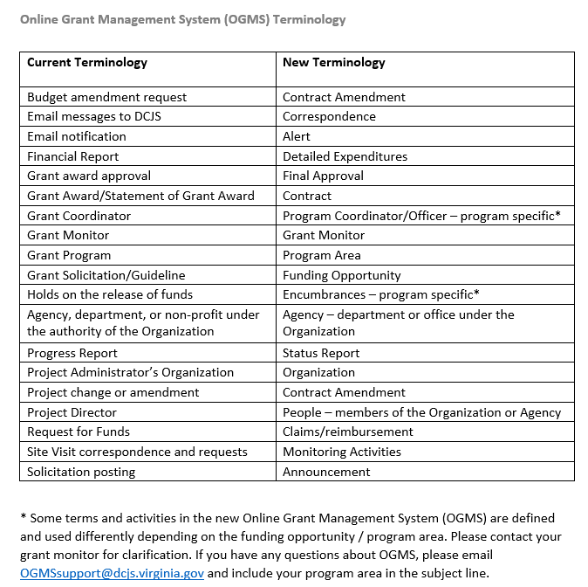
Online Grant Management System (OGMS) Terminology

Slide 7
Applying for FY 22 CASA Funding Opportunity
General Pointers for Navigating the WebGrants System
Editing Forms
Multi-list sections
Creating Rows
Additional Notes Before You Start Your Application
Use the WebGrants Menu, not the Browser Menu.
Read the instructions on the screen for navigating in the system.
Notes:
Most forms are editable by clicking ‘Edit’ at the top part of the section of the form. However, multi-list sections are editable by clicking ‘Add’ on the section. If you are completing a multi-list section, you can create as many rows as necessary to complete the section. If you want to delete a row, you will click on the row and click ‘Delete.’

Slide 8
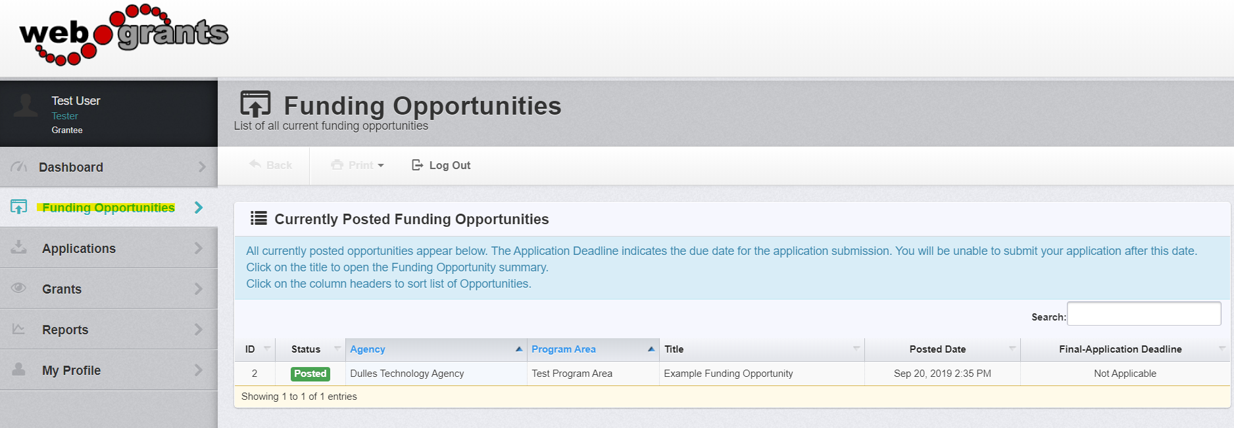
Applying for FY 22 CASA Funding Opportunity (cont.)
Creating an Application

Slide 9
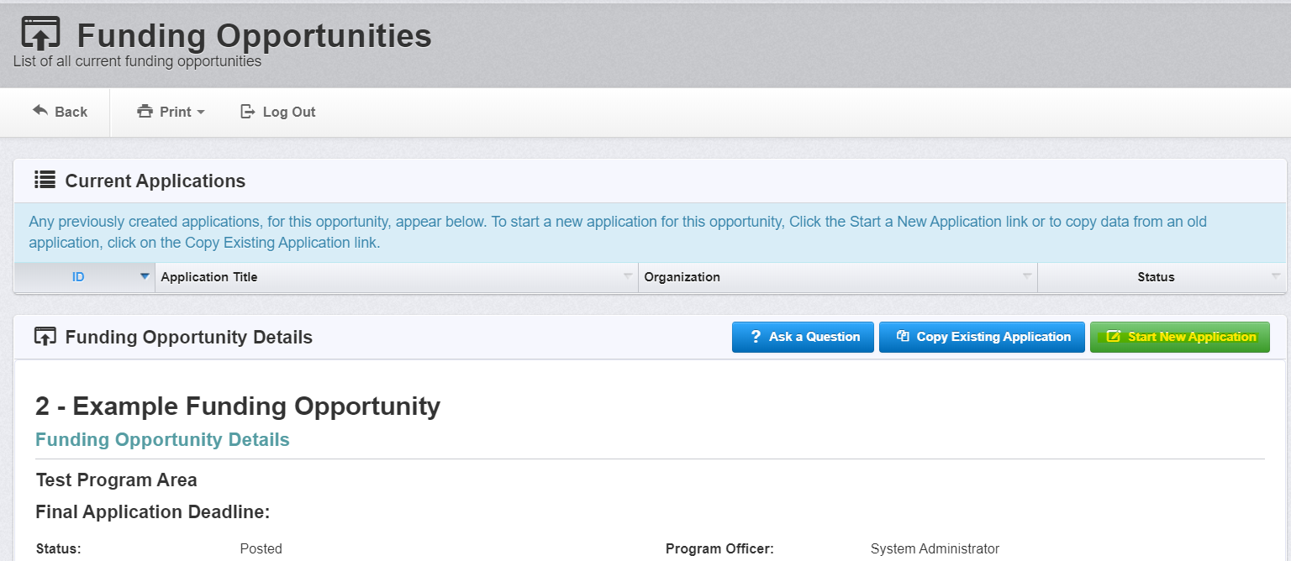
Applying for FY 22 CASA Funding Opportunity (cont.)
Creating an Application (cont.)

Slide 10
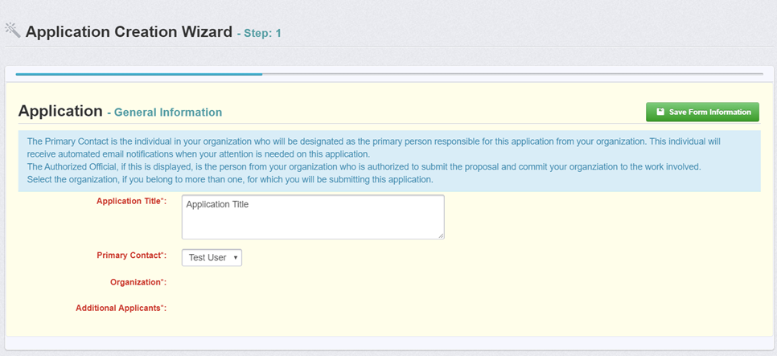
Applying for FY 22 CASA Funding Opportunity (cont.)
General Information Page

Slide 11
Application Components
General Information
Face Sheet
CASA Budget
Funds from other Sources
CASA Program Performance Targets
CASA Statement of Assurance
CASA Program Staff to Volunteer Ratio Calculation
CASA Program Requirements Assurance Form
CASA Documentation
Project Costs
Attachments
Non-Supplantation
Civil Rights Certification of Compliance
Authority Certification

Slide 12
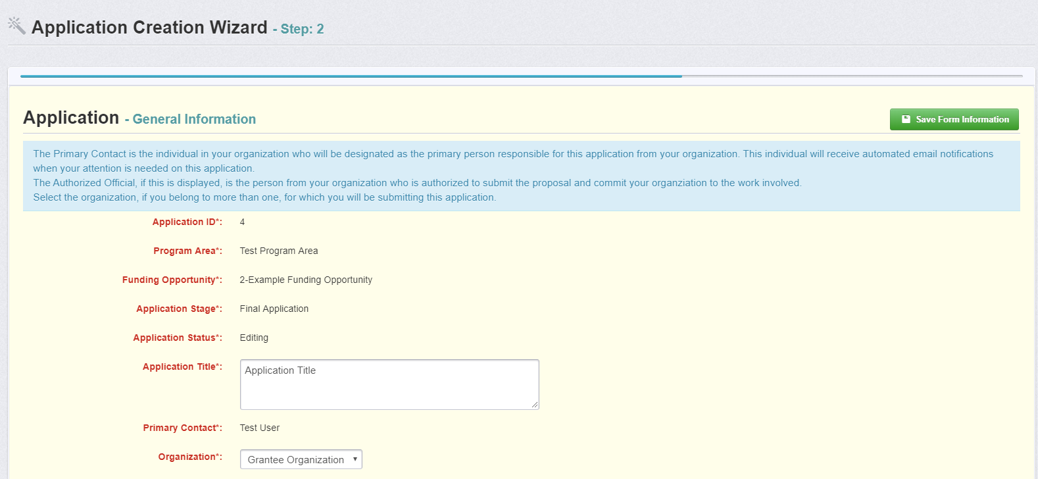
General Information Component
Notes:
The information for this component will pull from the information you provided when you completed your registration. Please verify that the information is correct. If incorrect, please ‘Edit Profile.’
Name: (The individual in your organization who will be designated as the primary person responsible for this application from your organization)
Title: (Primary Contact’s Job Title)
Email: (Primary Contact’s email address)
Address: (Primary Contact’s mailing address)
Phone: (Primary Contact’s phone #)

Slide 13
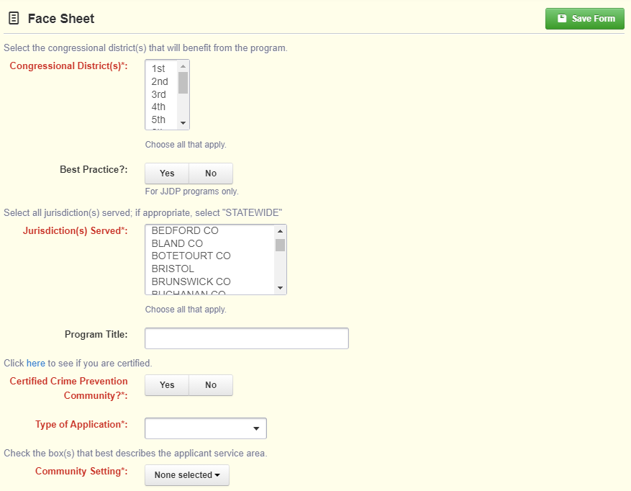
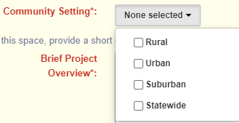
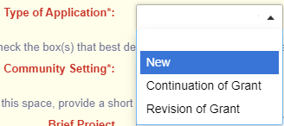
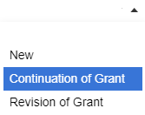
Face Sheet Component

Slide 14
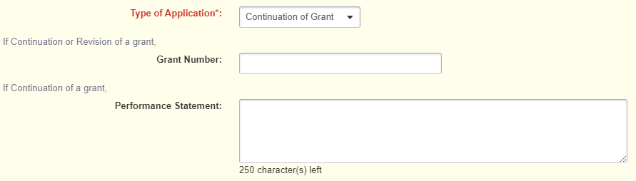
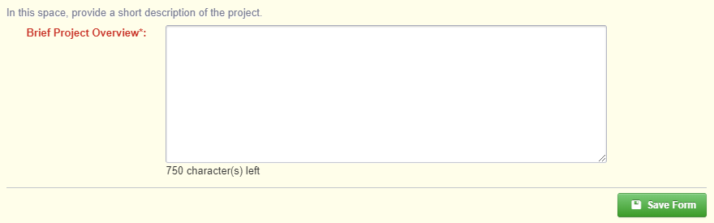
Face Sheet Component (cont.)

Slide 15
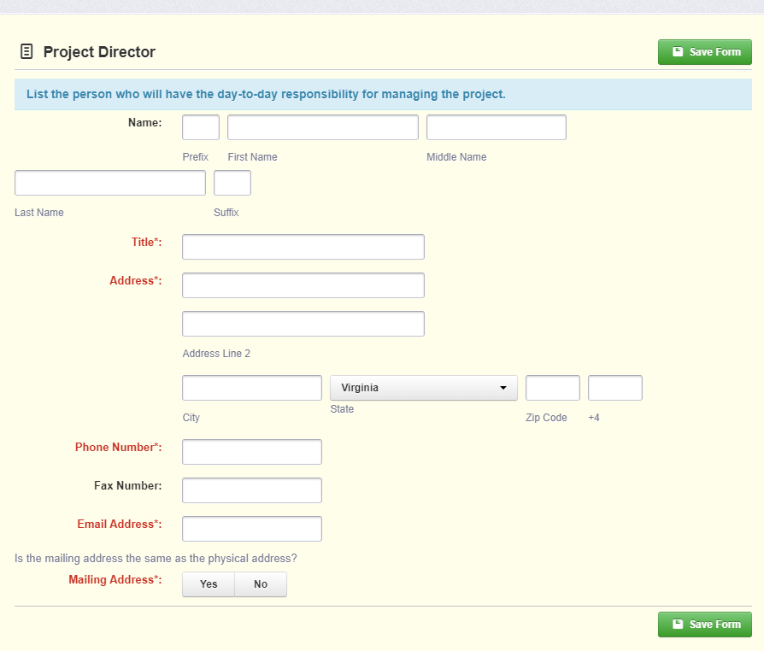
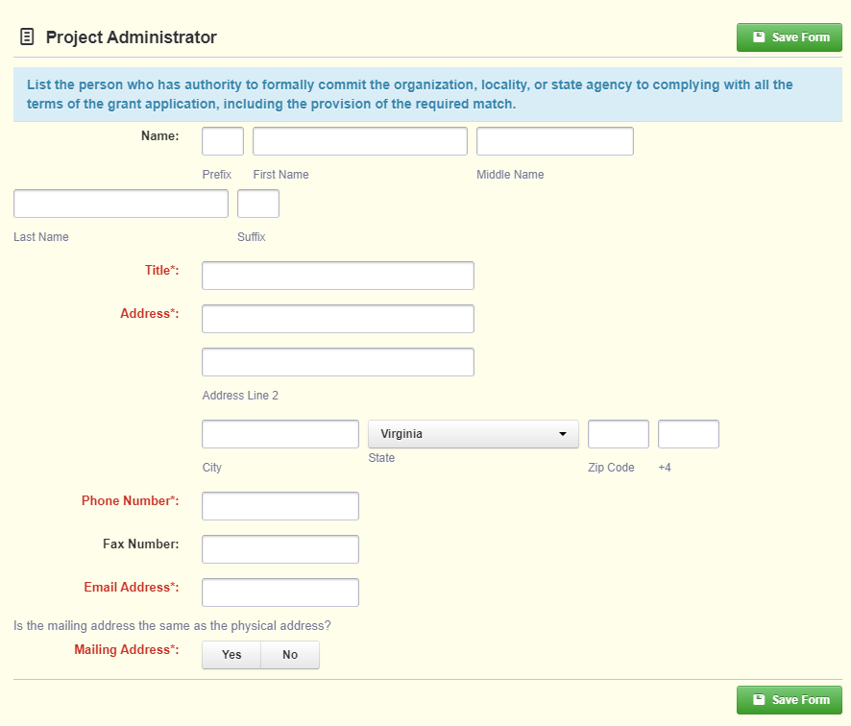
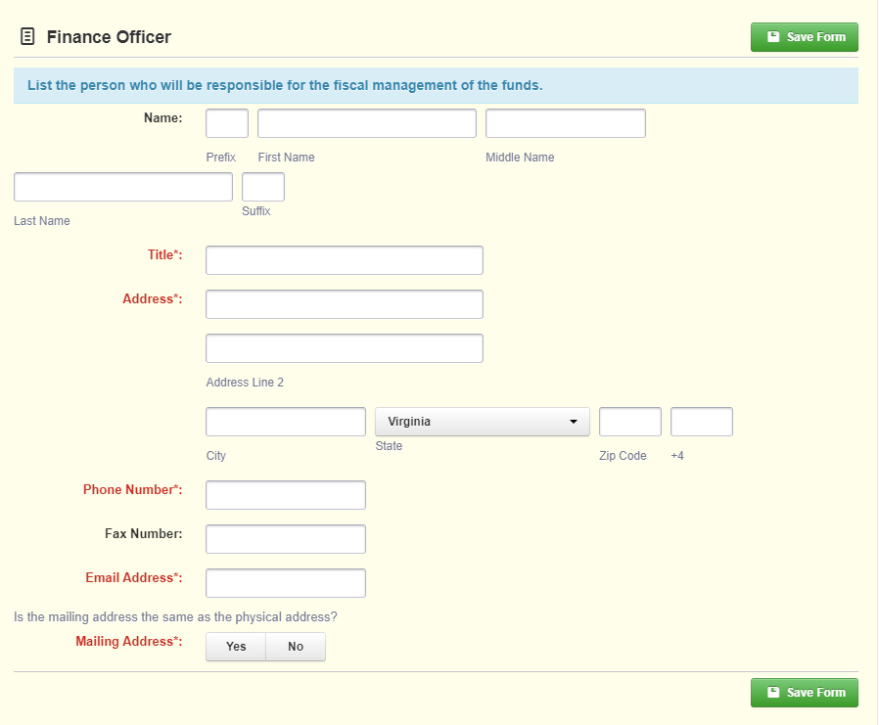
Face Sheet Component (cont.)

Slide 16
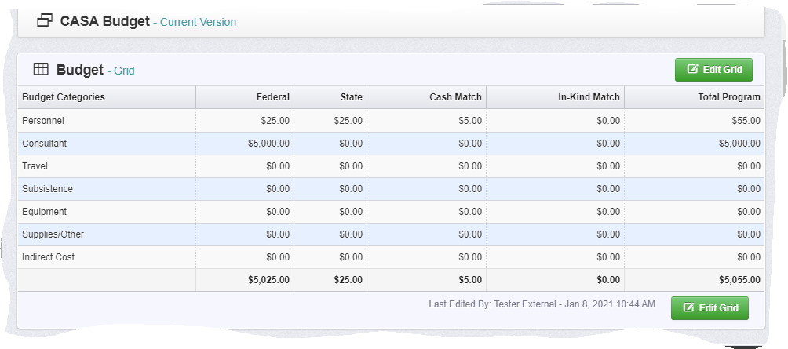
CASA Budget Component

Slide 17
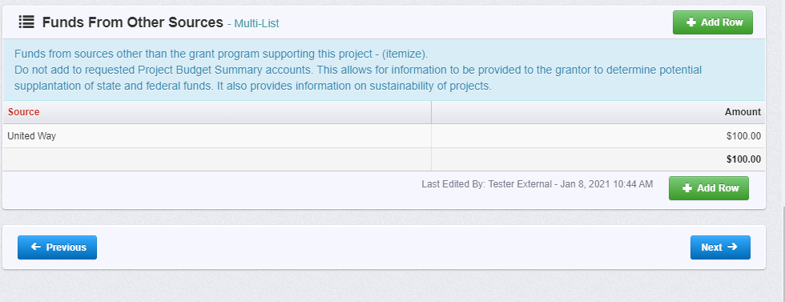
Funds From Other Sources Component

Slide 18
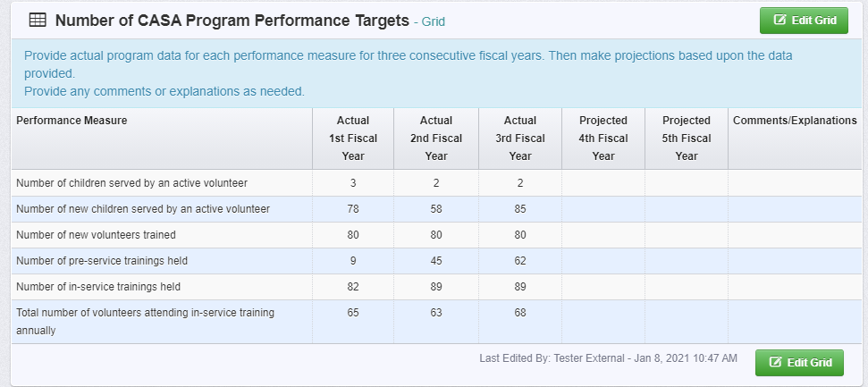
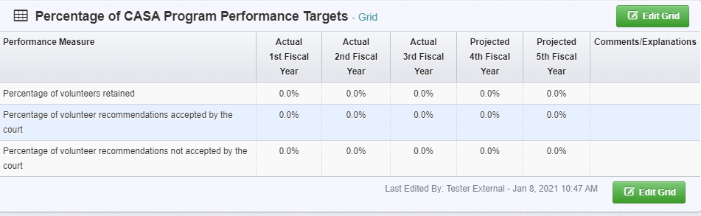
CASA Program Performance Targets Component

Slide 19
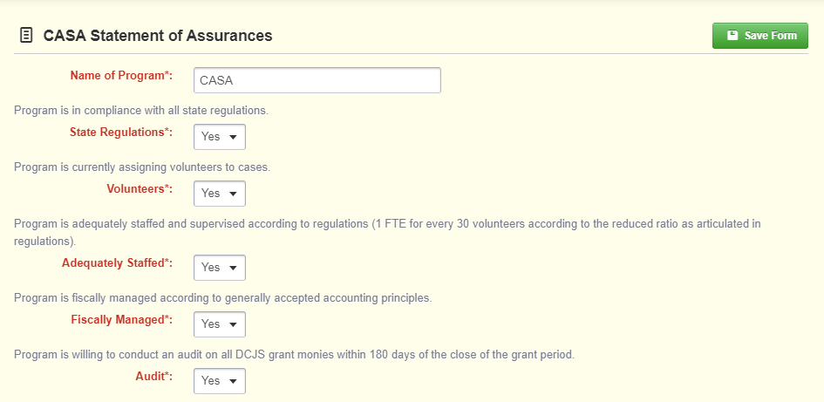
CASA Statement of Assurances

Slide 20
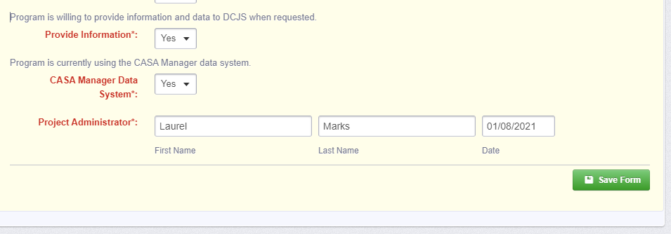
CASA Statement of Assurances (cont.)

Slide 21
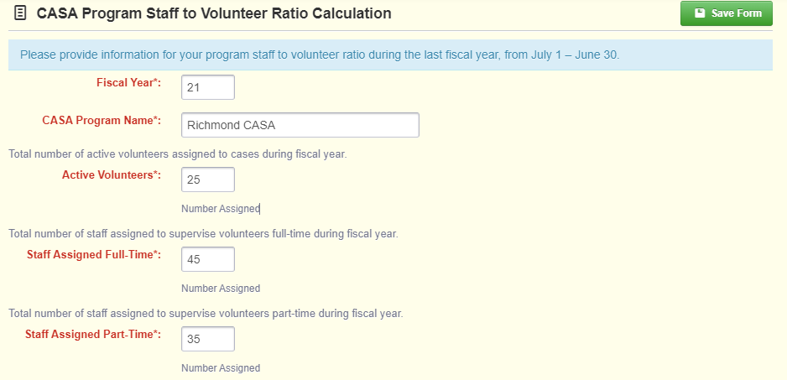
CASA Program Staff to Volunteer Ratio Calculation Component

Slide 22
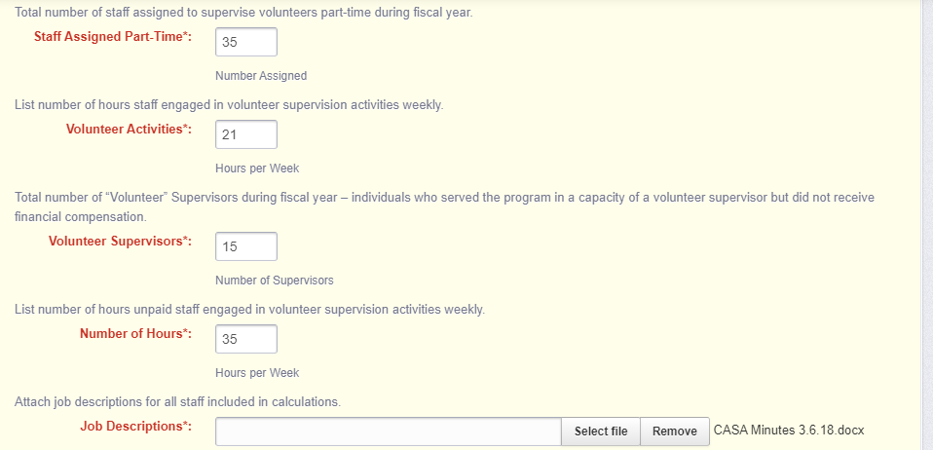
CASA Program Staff to Volunteer Ratio Calculation Component (cont.)

Slide 23
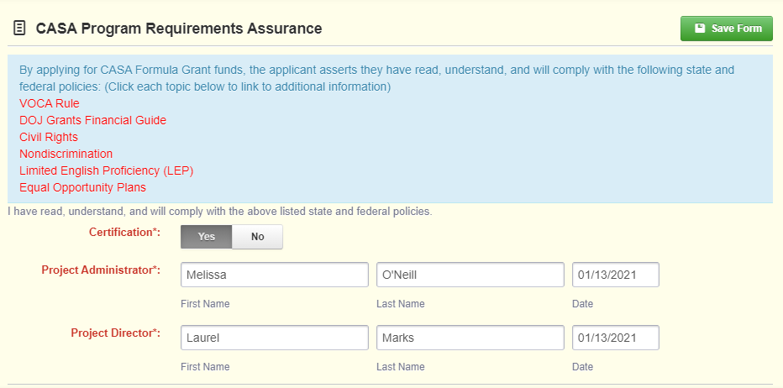
CASA Program Requirements Assurance

Slide 24
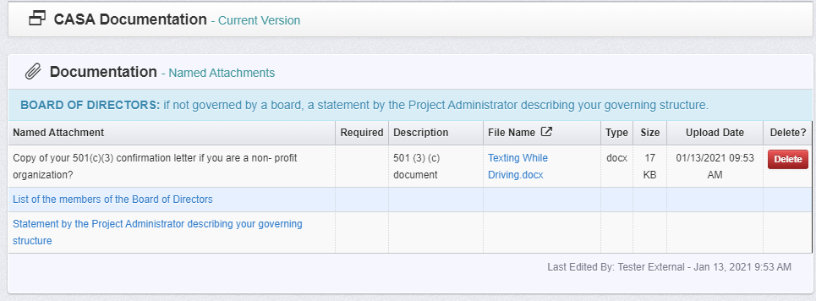
CASA Documentation Component

Slide 25
Project Costs
The Grantee should explain the reason for each requested budget item and provide the calculation basis for its cost.
All requested items must be justified and related to the CASA program.
VOCA funds must be allocated to direct services for child victims of crime.
Since this grant application includes both VOCA and state general fund sources, some budget items may be allocated from state general funds but may not be allowable under VOCA guidelines.
Applicants should reference the VOCA Guidelines for guidance on allowable and unallowable budget expenses under VOCA.

Slide 26
Project Costs (cont.)
When completing the Costs and Justification consider the following:
Each line item of the budget must reflect the same totals across all components of the grant application.
For example, the amount requested in Personnel should be the same in the Budget Component. Applicants are encouraged to review components prior to submission to avoid errors, reduction in awards, or special conditions.
All amounts must be rounded to the nearest dollar.
For example, instead of this: $45,456.50; round up: $45,457.

Slide 27
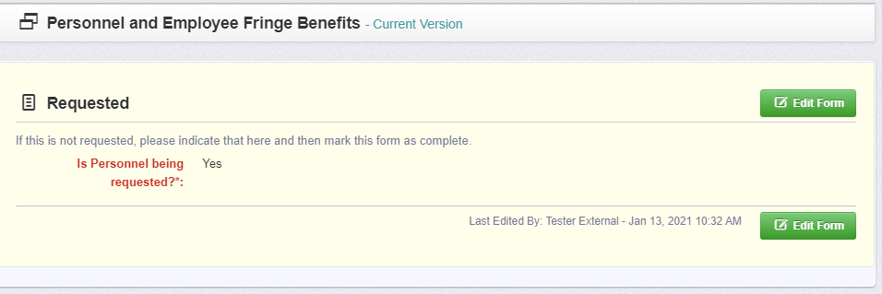
Personnel and Employee Fringe Benefits Component

Slide 28
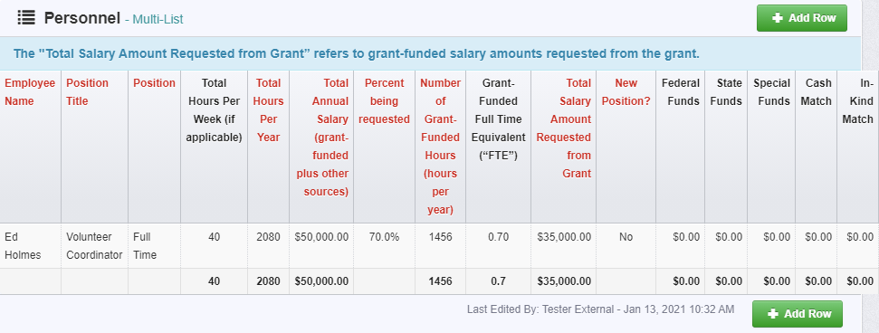
Personnel Component

Slide 29
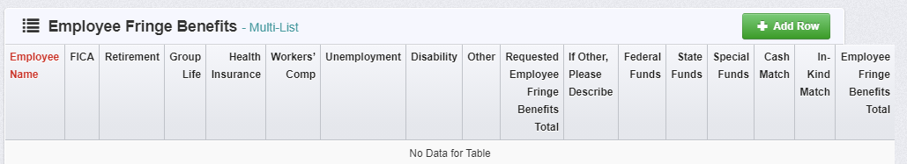
Employee Fringe Benefits Component

Slide 30
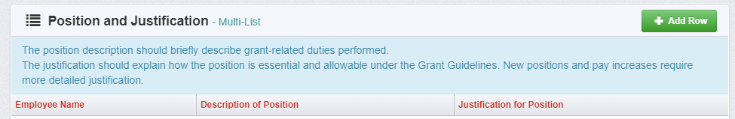
Position and Justification Component

Slide 31
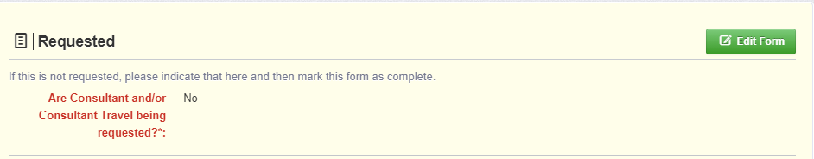
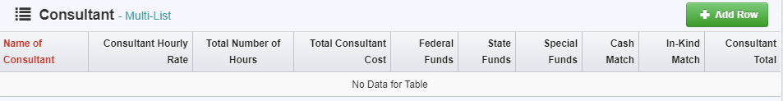
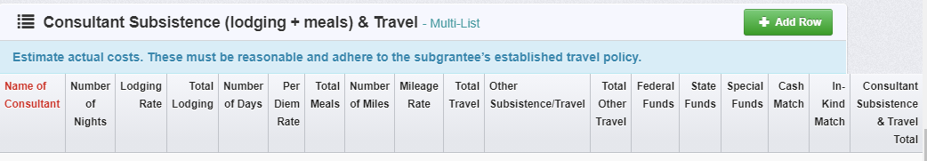
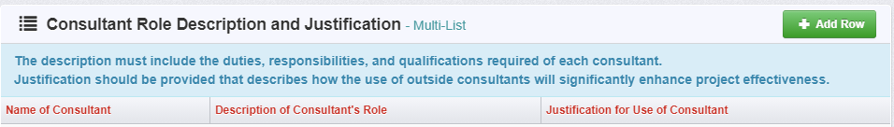
Consultants Component

Slide 33
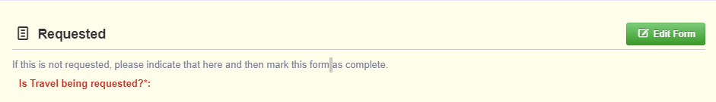
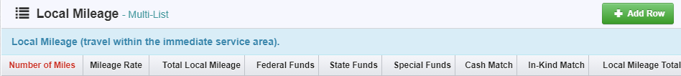
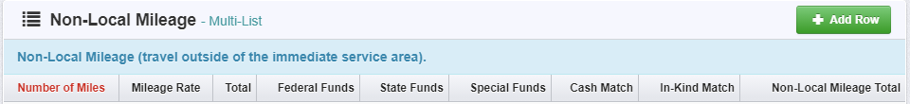
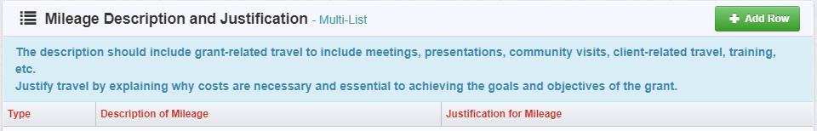
Travel Component

Slide 34
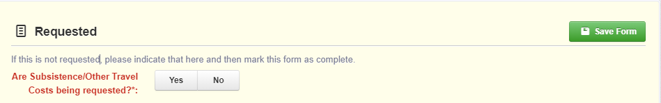
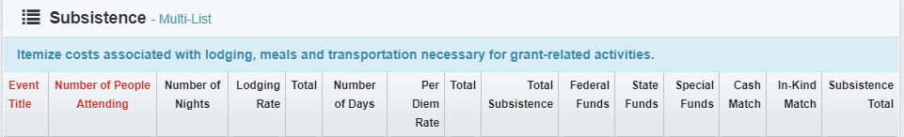
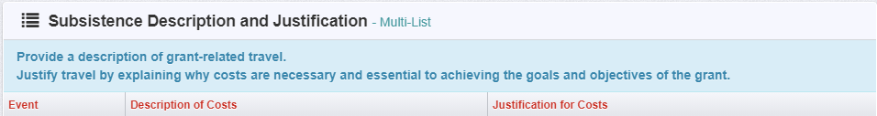
Subsistence Component

Slide 35
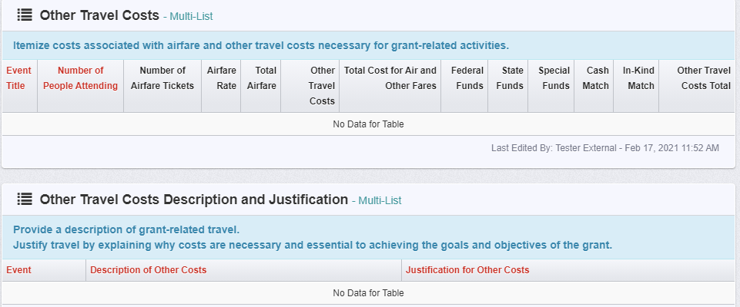
Other Travel Costs

Slide 36
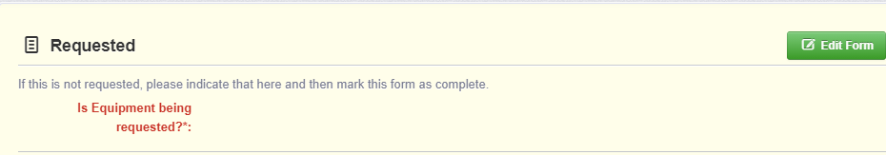
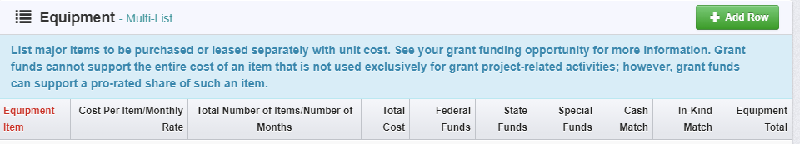
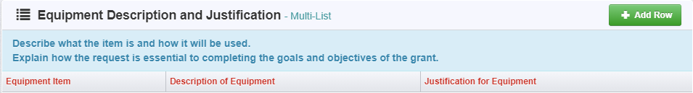
Equipment Component

Slide 37
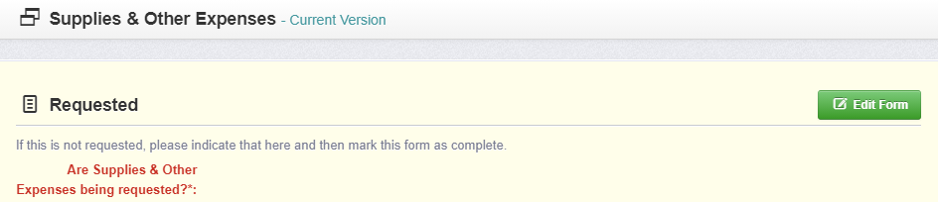
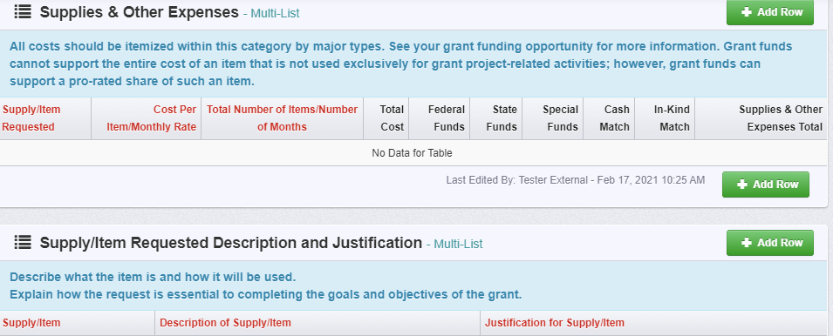
Supplies & Other Expenses

Slide 38
Indirect Costs Component
Defining Indirect Costs
Indirect costs are costs of an organization that are not readily assignable to a particular project, but are necessary to the operation of the organization and the performance of the project.
Indirect costs are those that benefit from more than one activity and are common or joint purpose costs.
For example, costs of an office manager/receptionist position that answers general phone calls, greets clients, etc. may be considered indirect costs.

Slide 39
Indirect Costs Component (cont.)
The salaries of administrative and clerical staff should generally be treated as indirect costs.
Salaries of administrative/clerical staff may be appropriate to include as direct costs ONLY if ALL of the following conditions are met:
Administrative or clerical services are integral to a project or activity;
Individuals involved can be specifically identified with the project or activity;
Such costs are explicitly included in the budget or have the prior written approval of the awarding agency; AND
The costs are not also recovered as indirect costs.

Slide 40
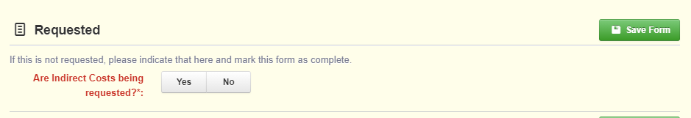
Indirect Costs Component (cont.)
Requesting indirect costs is optional.
Applicants do not have to request indirect costs, but it is allowable.
Two Options When Requesting Indirect Costs
Formal Indirect Cost Rate Agreement (ICRA)
De Minimis Rate

Slide 41
Indirect Costs Component (cont.)
This can be used by organizations that have never had a federally-approved Indirect Cost Rate Agreement
Can use a rate of up to 10 percent of the Modified Total Direct Costs (MTDC) of their budget for indirect costs
Requesting De Minimis Indirect Cost
Use the “MTDC Worksheet” (attached to email) to calculate the MTDC amount.
The Worksheet will also calculate the amount of indirect costs that can be requested.

Slide 42
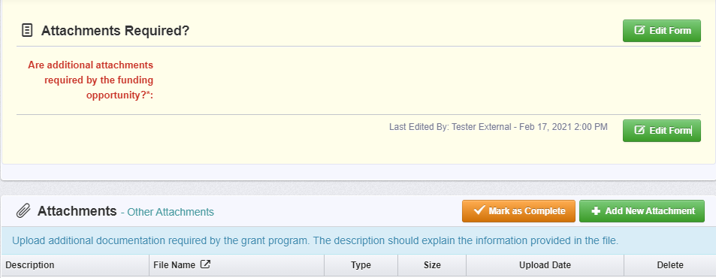
Attachments Component
MTDC Worksheet (Excel document) if applicable
AND
Certification of De Minimis Indirect Cost Rate Form if applicable
OR
A copy of the applicant’s Indirect Cost Rate Agreement letter/documentation if applicable
FY22 Projected Budget

Slide 43
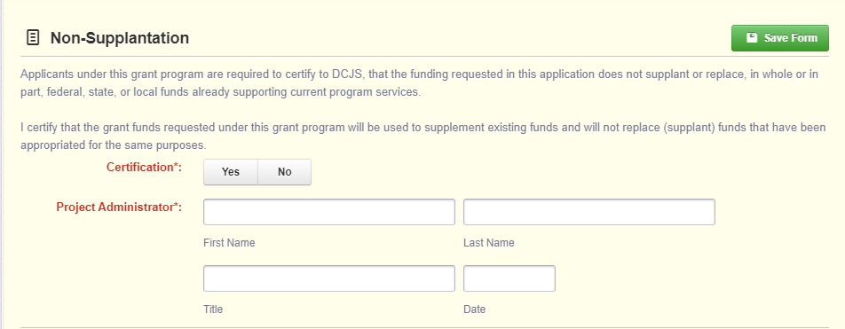
Non-Supplantation Component

Slide 44
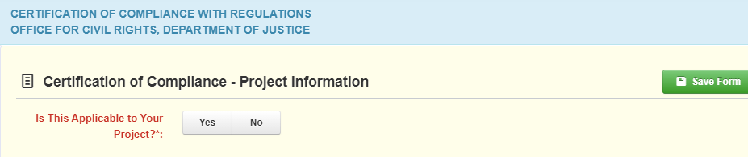
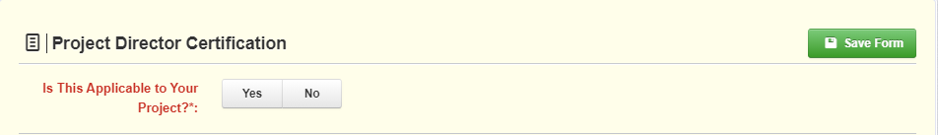
Civil Rights Certification of Compliance Component

Slide 45

Civil Rights Certification Compliance Component (cont.)

Slide 46

Authority Certification Component

Slide 47
Navigating in the WebGrants System Reminders
All information must be saved by clicking ‘Save’ on the forms.
If you do not click ‘Save’ and you back out of the form or section of the form, your information will be lost.
If you log out of the system at any point, DO NOT CLICK ON START A NEW APPLICATION to get back into your application.

Slide 48

Navigating in the WebGrants System Reminders
Once you have completed the entire application and marked all forms complete, your application is ready to submit.
You will notice that header has turned green.

Slide 49

Navigating in the WebGrants System Reminders
Submitting the Completed Application
You will receive a pop-up confirmation informing you that once you click ‘Submit’ the system will no longer let you edit the application.
If ready, click ‘Submit.’
The system will take you back to your Current Applications listing and will show you your submitted application.

Slide 50
Submission Deadline
Grant application documents must be completed and submitted online by 5:00 pm on March 26, 2021.

Slide 51

DCJS Staff Contact
Terry Willie-Surratt, CASA Grant Monitor and Quality Assurance Coordinator
804-225-4320 or terry.willie-Surratt@dcjs.Virginia.gov

